Slide 1
Werner Mohr
Chair of the board of 5G Infrastructure Association
http://5g-ppp.eu/

Slide 2
Outline
  5G overview
  Call 1 project portfolio
  Relation to vertical sectors
  Call 2 objectives
  Time plan and exploitation
  Networking opportunities

Slide 3
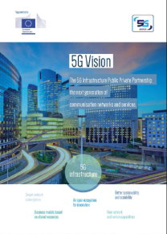
5G PPP in Horizon 2020 of the EU
5G PPP is a research program in Horizon 2020 of the EU dedicated to 5G system research
Budget for 2014 – 2020 time frame
  Up to 700 million € public funding
  Matched by private side including leveraging factor 5 of additional private investment results in private value of about 3.5 billion €
Research program is addressing all building blocks of a future communication network and a huge number of huge cases from vertical sectors
5G Infrastructure Association vision paper published at Mobile World Congress 2015 in Barcelona
http://5g-ppp.eu/wp-content/uploads/2015/02/5G-Vision-Brochure-v1.pdf
First set of projects started on July 1, 2015
Source: 5G Infrastructure Association.
20/01/2016

Slide 4
Key challenges
PPP Program that will deliver solutions, architectures, technologies and standards for the ubiquitous 5G communication infrastructures of the next decade
Program Ambitions: Key Challenges / High level KPIs
    Providing 1000 times higher wireless area capacity and more varied service capabilities compared to 2010
    Saving up to 90% of energy per service provided. The main focus will be in mobile communication networks where the dominating energy consumption comes from the radio access network
    Reducing the average service creation time cycle from 90 hours to 90 minutes
    Creating a secure, reliable and dependable Internet with a “zero perceived” downtime for services provision
    Facilitating very dense deployments of wireless communication links to connect over 7 trillion wireless devices serving over 7 billion people
    Enabling advanced User controlled privacy
20/01/2016
4
Source: 5G Infrastructure Association.

Slide 5
Governance model – Basic approach
Project Implementation
Phase I
Phase II
Phase III
Phase IV
Project N
Project N
Project N
Project N
Project 3
Project 3
Project 3
Project 3
<<<<<<<<<<<<<<<<<<<<<<<
Active PPP Projects
Steering Board
Technology Board
Consortium Agreement per project signed by all project partners
5G Infrastructure Collaboration Agreement across all projects in all Phases and signed by all partners
Project 2
Project 2
Project 2
Project 2
Industry Advisory Group
Project 1
Project 1
Project 1
Project 1
Topic area 6
Topic area m
Topic area m
Topic area m
Topic area 4
Topic area 5
Topic area 5
Topic area 7
Topic area 1
Topic area m
Topic area 2
Topic area 3
Topic area 6
Topic area 5
Topic area 2
Topic area 3
Topic area 4
Cross Issues
Topic area 7
Topic area 5
Topic area 1
Topic area 7
Topic area 1
Topic area 3
Topic area 2
Topic area 3
Topic area 2
Topic area 4
Topic area 4
Topic area 1
Topic area 7
Topic area 6
Topic area 6
20/01/2016
Source: 5G PPP Annex to contractual arrangement.

Slide 6
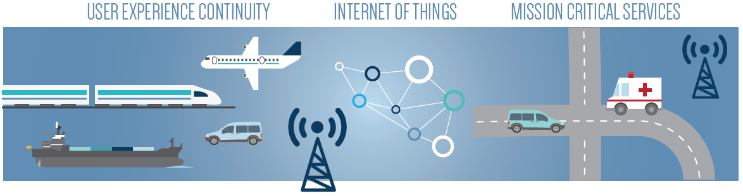
5G PPP Vision and Requirements
5G new service capabilities
5G needs to support efficiently three different types of traffic profiles
  high throughput for e.g. video services
  low energy for e.g. long–living sensors
  low latency for mission critical services
5G covers network needs and contributes to digitalization of vertical markets
  automotive, transportation, manufacturing, banking, finance, insurance, food and agriculture
  education, media
  city management, energy, utilities, real estate, retail
  government
  healthcare
Sustainable and scalable technology to handle
  anticipated dramatic growth in number of terminal devices
  continuous growth of traffic (at a 50-60% CAGR)
  heterogeneous network layouts
  without causing dramatic increase of power consumption and management complexity within networks
20/01/2016
Source: 5G Infrastructure Association: Vision White Paper, February 2015.

Slide 7
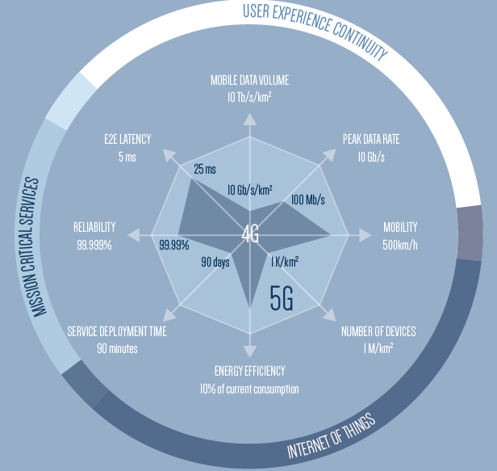
5G PPP Vision and Requirements
5G will have disruptive capabilities
5G will provide an order of magnitude improvement in performance in the areas of more capacity, lower latency, more mobility, increased reliability and availability
5G infrastructures will be also much more efficient in terms of
  energy consumption
  service creation time
  hardware flexibility
20/01/2016
Source: 5G Infrastructure Association: Vision White Paper, February 2015.

Slide 8
















International activities on 5G getting momentum
ITU-R Visions Group
EU
  Framework Program 7, e.g. METIS and 5GNow projects
  5G PPP in Horizon 2020
Germany – 5G Lab Germany at TU Dresden
UK – 5G Innovation Centre (5GIC) at University of Surrey
US
  Intel Strategic Research Alliance (ISRA)
  NYU Wireless Research Center
  4G Americas, MoU - signed
China
  863 Research Program
  Future Forum
  IMT-2020 (5G) Promotion Group, MoU - signed
Japan – The 5G Mobile Communications Promotion Forum, MoU - signed
Korea – 5G Forum, MoU - signed
Taiwan – TAICS, Ministry of Science and Technology, Ministry of Economic Affairs
Russia – 5GRUS by Russia’s Icom-Invest
CJK White Paper
NGMN – White paper on future requirements
Company internal research
Multilateral MoU on a series of Global 5G Event signed on October 20, 2015 in Lisbon
  Two events per year, rotation between continents
20/01/2016
Source: 5G Infrastructure Association.

Slide 9
Horizon 2020 5G PPP
Call 1 selected projects
Radio-related cluster
5G Ensure
Security
(Will be added later)
Fronthaul/Backhaul
CogNet
Building an Intelligent System of Insights and Action for 5G Network Management
SELFNET
Framework for SELF-organized network management in virtualized and software defined NETworks
CHARISMA
Converged Heterogeneous Advanced 5G Cloud-RAN Architecture for Intelligent and Secure Media Access
Hardware implementation
Network automation
SDN, NFV, Cloud and
Virtualisation
SUPERFLUIDITY
Superfluidity: a super-fluid, cloud-native, converged edge system
5GEx
5G Exchange
VirtuWind
Virtual and programmable industrial network prototype deployed in operational Wind park
SONATA
Service Programming and Orchestration for Virtualized Software Networks
Security
COHERENT
Coordinated control and spectrum management for 5G heterogeneous radio access networks
5G-Norma
5G NOvel Radio Multiservice adaptive network Architecture
METIS-II
Mobile and wireless communications Enablers for Twenty-twenty (2020) Information Society-II
SPEED-5G
quality of Service Provision and capacity Expansion through Extended-DSA for 5G
SESAME
Small cEllS coordinAtion for Multi-tenancy and Edge services
FANTASTIC-5G
Flexible Air iNTerfAce for Scalable service delivery wiThin wIreless Communication networks of the 5th Generation
5G-Xhaul
Dynamically Reconfigurable Optical-Wireless Backhaul/Fronthaul with Cognitive Control Plane for Small Cells and Cloud-RANs
Flex5Gware
Flexible and efficient hardware/software platforms for 5G network elements and devices
Crosshaul
The 5G Integrated fronthaul/backhaul
mmMAGIC
Millimetre-Wave Based Mobile Radio Access Network for Fifth Generation Integrated Communications
Euro-5G
5G PPP Coordination and Support Action
Source: EURO-5G.

Slide 10
Vertical sectors
White papers on
  5G and Factories of the Future
  5G and Healthcare
  5G and Energy
  5G and Media (under preparation)
  5G and Automotive
Identification of
  main use cases
  requirements and
  areas for research and innovation
  Vertical workshops
  June 18, 2015
  November 9, 2015
Source: 5G Infrastructure Association.
20/01/2016

Slide 11
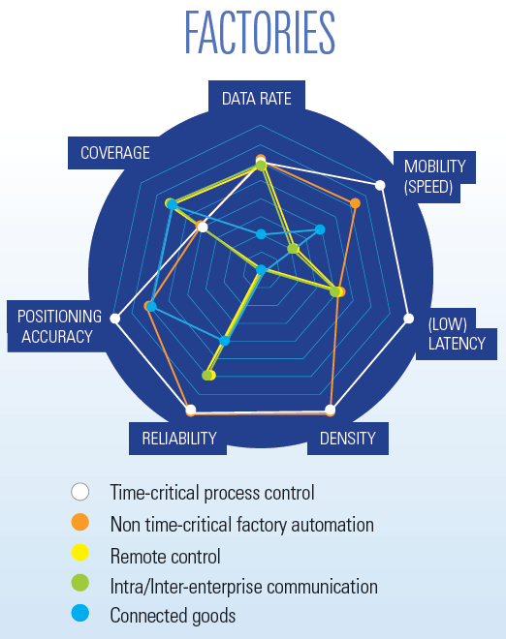
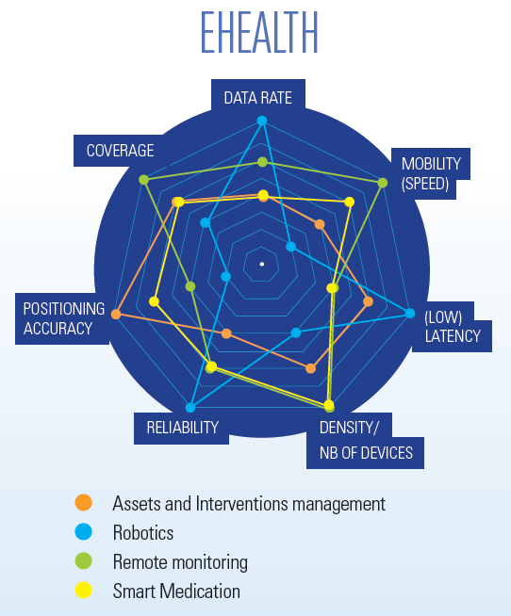
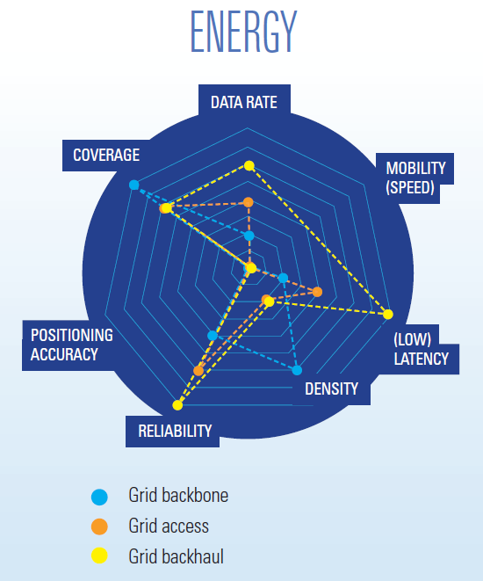
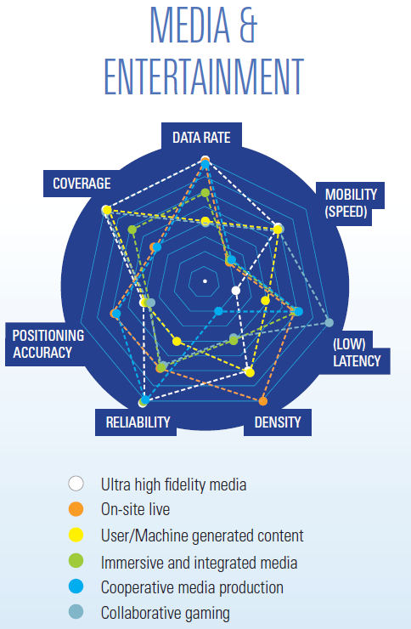
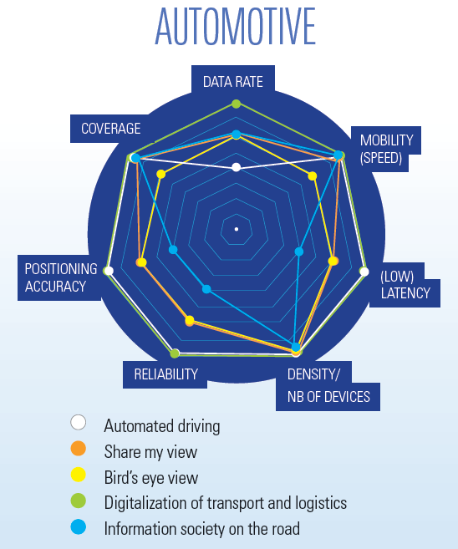
Vertical sectors
Main technical requirements
20/01/2016
Source: 5G Infrastructure Association: Vision White Paper, February 2016.

Slide 12
Horizon 2020 5G PPP Call 2 objectives
154 million € Funding including joint calls
ICT-07-2017: 5G PPP Research and Validation of critical technologies and systems
ICT-08-2017: 5G PPP Convergent Technologies
(EUJ-01-2016: Joint Call EU-Japan, different timing)
(EUK-01-2016: Joint Call EU-Korea, different timing)
Call 2: Opening May 10, 2016, Closing November 8, 2016
Wireless access and radio network architecture/ technologies
Novel air interface technologies, heterogeneous set of requirements (low rate sensors including mission critical M2M to very high rate HD/3D TV and immersive services, supporting local and wide area systems), enabling usage of frequency bands above 6 GHz
Hardware architectures technologies and building blocks
(Radio) Network functional architectures and interfaces leading to vision / reference architecture for 5G
Co-operative operation of heterogeneous access networks, including broadcast/multicast (terrestrial and satellite based) and supporting SDN and virtualization
Multi-tenancy for Radio Access Network (RAN) sharing
Integration of Satellite Networks to support ubiquitous coverage, resilience, specific markets
High capacity elastic - optical networks
Support very high traffic and capacity increase originating from an (5G) heterogeneous access networks with matching capabilities from the core and metro environments, at ever increasing speeds and in more flexible and adaptive form
New spectrally efficient, adaptive transmission, networking, control and management approaches to increase network capacity by a factor of >100 while at the same time providing high service granularity, guarantees for end-to-end optimization and QoS - reducing power consumption, footprint and cost per bit and maintaining reach
Integration of new optical transport and transmission designs with novel network control and management paradigms (e.g., SDN) are expected to enable programmability
Software Networks
Software network architecture to support access agnostic converged core network and control framework enabling next generation services
Architecture leverages SDN/NFV paradigm to integrate/manage next generation transport and optical technologies
Unified management of connectivity, with end to end security mobility and routing for flexible introduction of new services
Scalability and efficiency related to increasing deployment of software-based network equipment and functions as well as corresponding more diverse services and usages
Ease of deployment of multitenant networks, cost and energy efficiency, "five 9" reliability, flexibility and perceived "zero latency" where relevant
Target is for a Network Operating System (NOS) with hardware and user interfaces to manage and orchestrate unified access to computing, storage, memory and networking resources
Management and security for virtualised networks and services
Network analytics tools, knowledge reasoning and cognition, may be extended towards network operations
Management of security across multiple virtualised domains
Ubiquitous 5G access leveraging optical technologies
5G access networks have to dramatically grow in user capacity, quality of service, responsiveness, energy efficiency and number of connected devices while keeping a sustainable cost
To develop and assess new optical access network solutions based on integrated optical device prototypes
Co-operative radio-optical approaches are seen as very promising, also to cover intelligent interference cancellation
Techniques to map 5G channels to optical transport and a co-design of the optical and wireless interfaces and protocols
Scalable demonstrators validated through typical usage scenario
Flexible network applications
Leveraging current intense research activities in relation to Virtualised Network Functions (VNF) and targeting development of a multiplicity of VNF's useful to operators, service providers and users
Service providers or third party providers should be able to assemble virtualised 5G functions as "network apps" from NFV hosting infrastructure, to deploy them in the relevant network nodes, to orchestrate and customise resources to provision user services
Target is for a cloud like 5G infrastructures, supporting network services, resource and service orchestration
This environment also provides an open source development framework for control functionalities and application developments
It also provides the link between the network –terminal functions and the app/content providers towards standards developments
20/01/2016
Source: EU Commission Work Program 2016-2017 / 5G Infrastructure Association.

Slide 13
5G PPP Vision and Requirements
5G roadmap
20/01/2016
Source: 5G Infrastructure Association: Vision White Paper, February 2016.

Slide 14
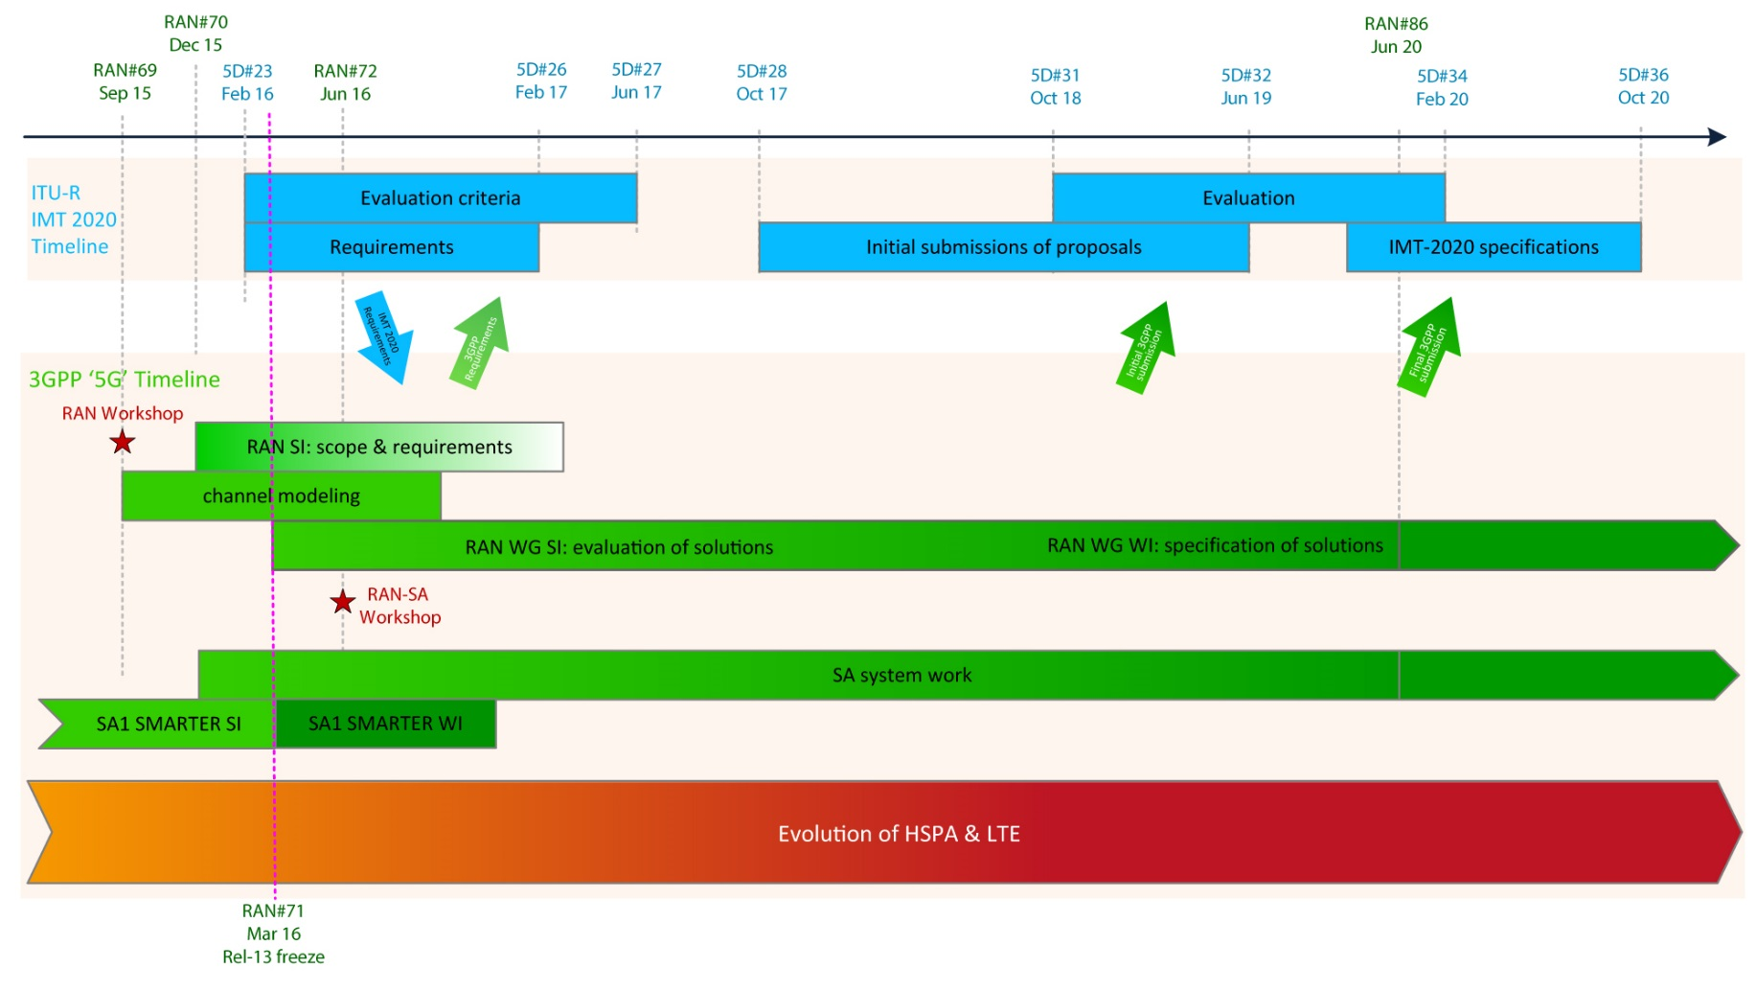
3GPP tentative time plan on 5G standardisation
20/01/2016
Source:3GPP, March 2015, http://www.3gpp.org/news-events/3gpp-news/1674-timeline_5g.

Slide 15




Exploitation of results
5G research in FP7 and
in the private sector
5G PPP Phase I
5G PPP Phase II
5G PPP Phase III
Results from FP7
Projects contributed
to ITU-R on 5G vision
and requirements
3GPP Work Items and 3GPP Releases
3GPP Study Items
ONF, Open Daylight, OPNFV, Open Stack, …
ITU-R Vision and Recommendation
WRC preparatory process
Trials
Contributions to standardisation and regulatory process via member organisations in respective bodies
Prototype and product development
Winter Olympics,
Korea
FIFA World Cup,
Russia 2018
Summer Olympics,
Japan
2012
2013
2014
2015
2016
2017
2018
2019
2020
FIFA World Cup,
Qatar 2022
20/01/2016
Release 14
15
Release 12
Release 13
Release 15
Source: 5G Infrastructure Association.

Slide 16
Networking opportunities
Networld2020 website: http://www.networld2020.org/
5G PPP website: https://5g-ppp.eu/
Participation in Networld2020 and 5G PPP activities like working groups
Preparation of a Pre-Structuring Model
    as recommendation to the community
    as a mapping of the Call for Proposals
    to Target Research Areas
Information days are planned in 2016
    first meeting on January 21, 2015 in Brussels
    further meetings are planned until June 2016
Brokerage Platform on 5G PPP website will be provided in 2016
Acknowledgement: The author would like to thank his colleagues for their contributions.
Source: 5G Infrastructure Association.
20/01/2016

Slide 17
http://5g-ppp.eu
Thank you for your attention!

