Slide 1
From 5G-PPP to Smart Networks and Services JU
Passing the Torch event
25 May 2023
Peter Stuckmann
Head of Unit, Future Connectivity Systems, DG CONNECT
Interim Executive Director, Smart Networks and Services Joint Undertaking

Slide 2
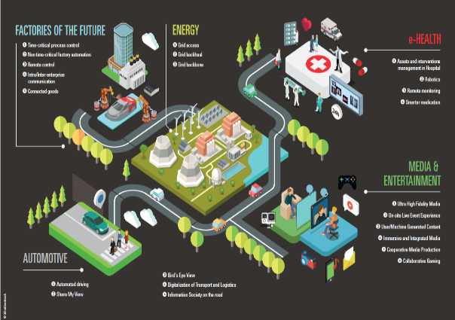
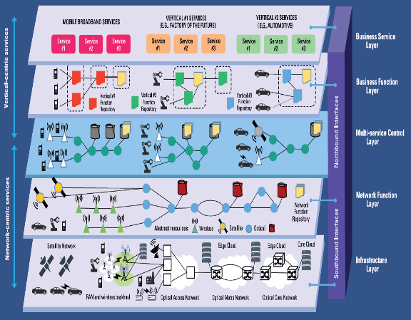
5G Research – The 5G PPP
PHASE 1: 5G Core Research
5G system design & evaluation aspects
5G air interface innovations
Network management & security innovations
Virtualisation & service deployment innovations
PHASE 2: System development & application in vertical industries
PHASE 3: Large scale trials and innovation infrastructures
2015
2016
2017
2018
2019
2020
5G technology leadership in EU with global impact
Programme-level collaboration among projects (working groups and task forces)
Major impact on 5G standards
5G platforms for trials and pilots all over Europe
Large community building, stakeholders from many business and academic sectors, good SMEs participation
Reference documentations, scientific publications, white papers, brochures

Slide 3
Step up our ambitions: SNS JU
5G PPP bridging phase
The Hexa-X flagship + 9 B5G/6G exploratory projects = 65 M€
Tasks set by Council Regulation (2021/2085)
EU upfront commitment of €900M between 2021-2017 (to be at least matched by industry)
Close involvement of Member States for strategic guidance
Dedicated Programme Office
Accelerating 5G Deployment
Connecting Europe Facility (CEF2)
6G Vision and R&I across the broader supply chain

Slide 4
A JOINT UNDERTAKING FOR 6G NETWORKS AND SERVICES
To facilitate and develop industrial leadership in Europe for 5G and 6G networks and services by 2030

Slide 5
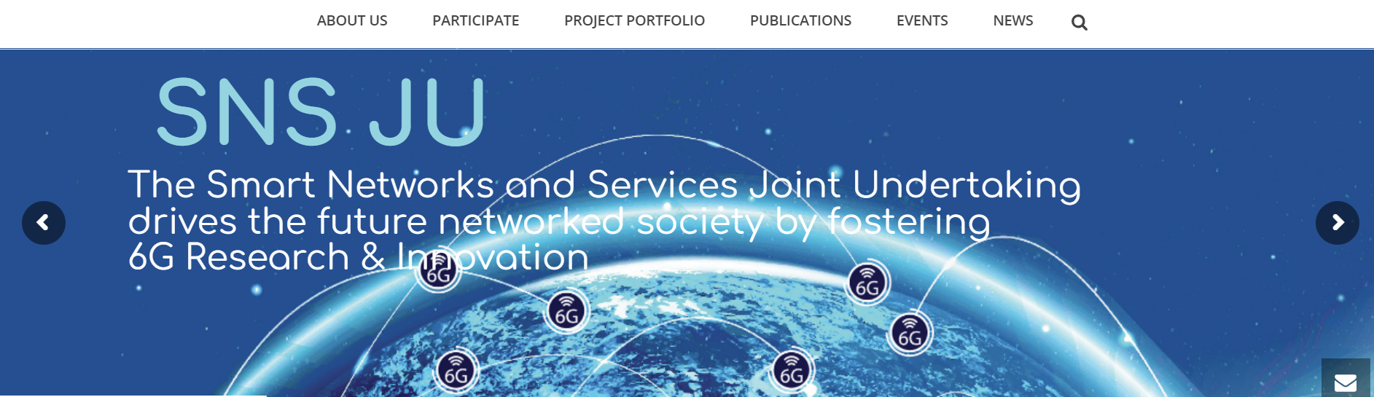
Thank you!
Visit SNS JU website: https://smart-networks.europa.eu/
@6G_SNS

Slide 6
Backup Slides

Slide 7
Call 2022: Funding and results

