Slide 1


Transition from
5G-PPP to SNS-JU
The Voice of European Industry and Research for Next Generation Networks and Services

Slide 2





5G PPP & SNS JU Overview (1/3)
The 5G Public Private Partnership (5G-PPP) and the Smart Networks and Services Joint Undertaking (SNS JU) are partnerships between
  the Public Sector - European Commission (EC)
  the Private Sector - 5G/6G Infrastructure / Industry Association (5G-IA / 6G-IA).
Both programs foster and promote EU Research & Innovation activities on the greater ICT sector focusing on 5G and 6G technologies
Public & private sector funds are used to support Work Programs of multiple targeted Research and Innovation Actions (Projects)
  5G-PPP → 2014 - 2021
  SNS JU → 2022 - 2030
5G-PPP projects are wrapping up and SNS projects began on 01/01/2023 under the Horizon Europe Framework

Slide 3
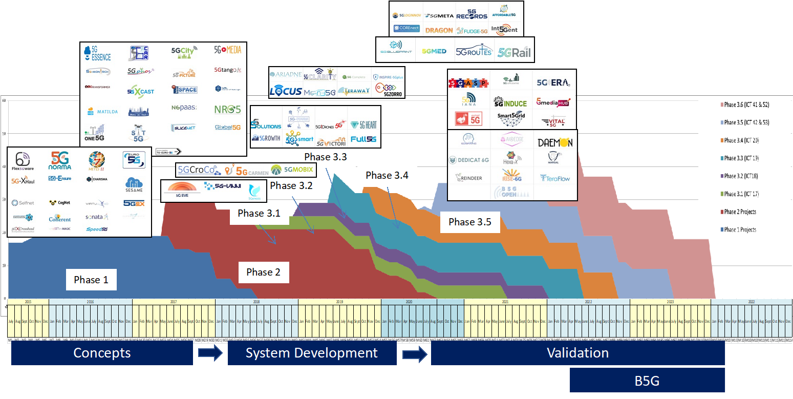
5G PPP & SNS JU Overview (2/3)
5G-PPP
93 R&I projects funded, grouped in 3 major phases starting in 2014
Different technologies, infrastructure, devices and verticals targeted per phase
5G-PPP Highlights
93 R&I Projects funded
More than 700 beneficiaries
800+ contributions to Standardization activities
2000+ scientific publications
40 White Papers (and counting)
445 Innovations in the Innovation Radar

Slide 4
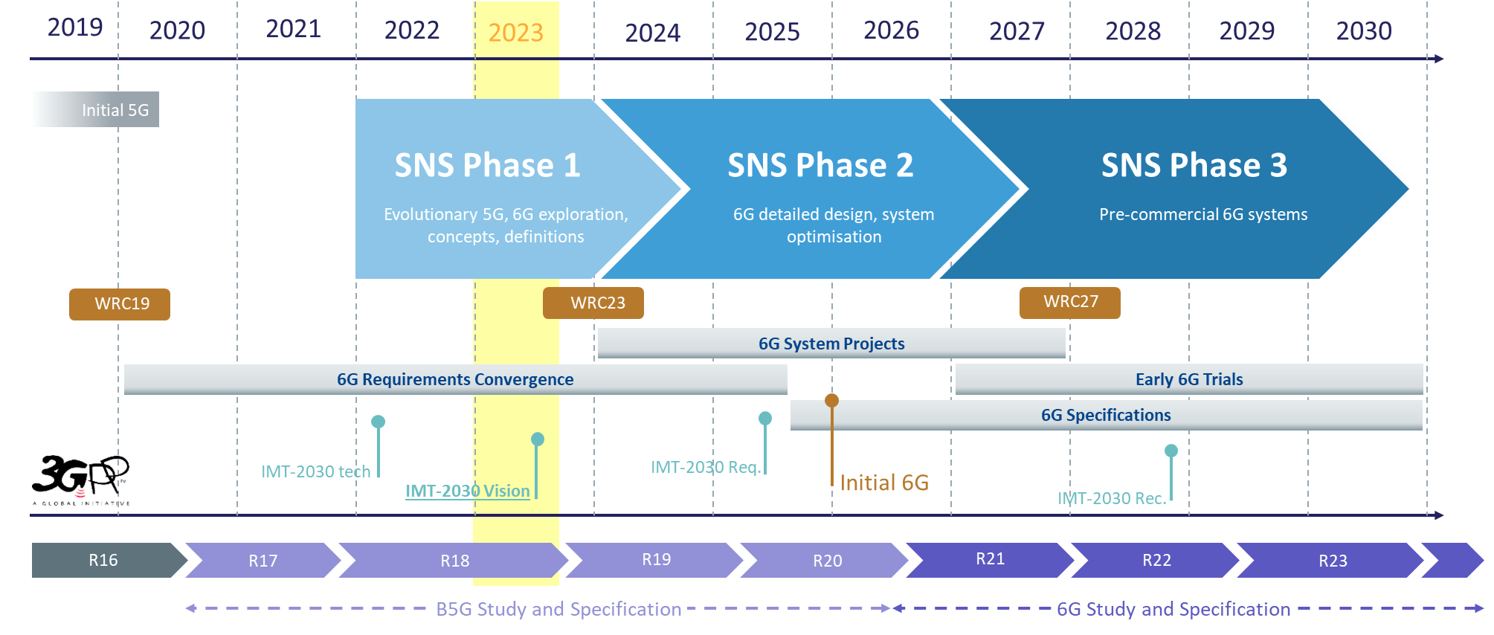
5G PPP & SNS JU Overview (3/3)
6G SNS
6G SNS is planned in 3 phases, funding R&I projects under 4 different Streams in a programme of ~1.8€ Billion (more info here)
First projects of phase 1 started on 01/01/2023

Slide 5
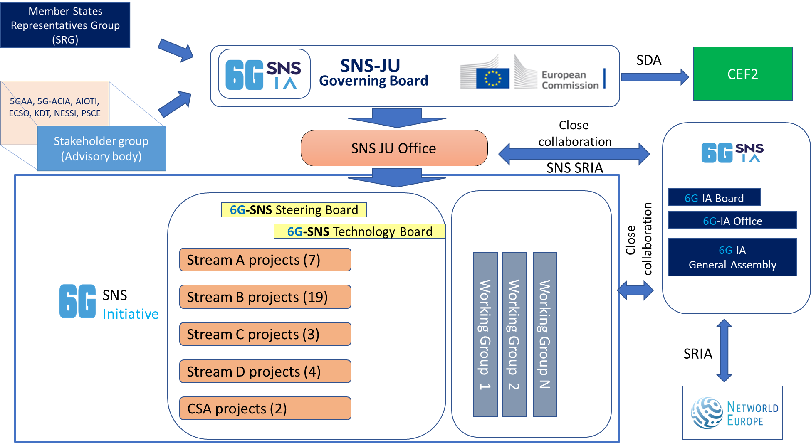
SNS Governance

Slide 6
SNS Governance
3 Types of WGs are considered
  SNS Project WGs (SNS SB)
  SNS Strategic WGs (SNS GB)
  6G-IA WGs (6G-IA GB)
Discussions are ongoing

Slide 7
SNS Collaboration Agreement
The Collaboration Agreement (CA) lays out the way of working, obligations and benefits of all SNS beneficiaries
The CA has been circulated to all projects to be signed by all beneficiaries
One signature is needed per PIC across all projects
Once 70% of SNS JU beneficiaries have signed the CA, the collaborative bodies, i.e., the Steering Board (SB) and the Technology Board (TB) may be set up
  Elections to be held for the positions of the SB/TB Chair and Vice-Chair
Priority No 1: Push for the signature of the CA by the project beneficiaries, to reach the 70% threshold ASAP

Slide 8

Thank you!
office@6g-ia.eu
The Voice of European Industry and Research for Next Generation Networks and Services

