Slide 1

5GPPP Software Network WG
Scope, Road So Far, & Way Forward
25 May 2023, 5GPPP to SNS JU: Passing the Torch Event
Dr Bessem Sayadi
NOKIA Bell-Labs FR
May 25th 2023

Slide 2
Software Networks WG Scope
WG created since beginning of 5G-PPP
Mission:
  Technology trend analysis,
  Demystify new tech trend,
  Place where projects can collaborate, share best practices,
  Collect Software released by projects
Our journey since 2016:
  transformation to Cloud Native to Service based design and API
  From VM to container to API
Telco
NFV SDN
NFV MANO
Cloud Native
Service based/API design
Webscale

Slide 3
Way of working
Each year, the WG set-up objectives:
  Topic of the White Paper
  Open-Sources: trend, collection
  Dissemination: Workshop/session in EuCNC, Globecom, ACM MobiHoc etc
  Contributions in 5G-PPP
WG organizes technical workshops on some focused area/techno. For example: Function as a Service, K8s, NUMA

Slide 4

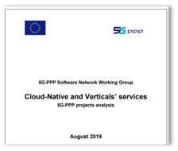
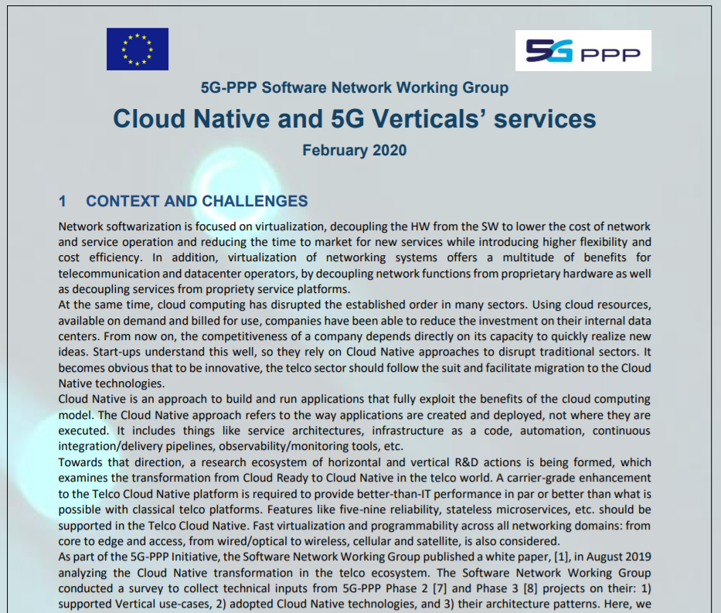
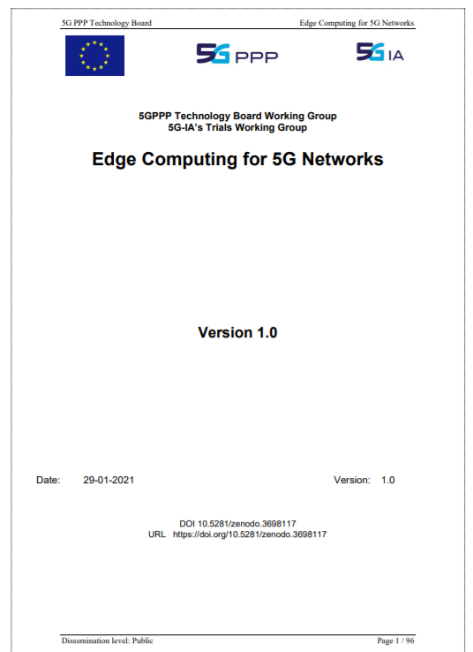

Software Networks WG outcomes
Wide participation from 5G-PPP
https://5g-ppp.eu/wp-content/uploads/2018/07/5GPPP-Software-Network-WG-White-Paper-July-2018.pdf
2018
https://5g-ppp.eu/wp-content/uploads/2019/09/5GPPP-Software-Network-WG-White-Paper-2019_FINAL.pdf
2019
MWC 2020
https://5g-ppp.eu/wp-content/uploads/2020/02/5G-PPP-SN-WG-5G-and-Cloud-Native.pdf
2020
https://bscw.5g-ppp.eu/pub/bscw.cgi/d397473/EdgeComputingFor5GNetworks.pdf
2021
All these technologies are strengthened in 6G
Truly Cloud Native system
More Distributed and Converged Architecture
EDGE ➔ Extreme EDGE
2022

Slide 5
Open-Source Collection
Important to be included in the outcome of the work programme in addition to standards:
  Conducted during Phase 1:
    The link to collect Phase 1 outcomes
    https://docs.google.com/spreadsheets/d/1C-9VjALm2cnTOLOem6yruTYKPgr5_Q9r0gtmRQhSyU0/edit#gid=0
  Followed in Phase2
    The link to collect Phase 2 outcomes
      https://docs.google.com/spreadsheets/d/1xEK5ooFEUPEXtHuomMUuJpkwMYQiIHLSixaORmdEutc/edit#gid=0
  Continued in Phase 3 through the collection of Network Applications:
    On-going
    https://docs.google.com/spreadsheets/d/1pNaDcfy_8AERvf-anisPFh5KIC_DeCoYhP0EXTXYJt4/edit#gid=0

Slide 6
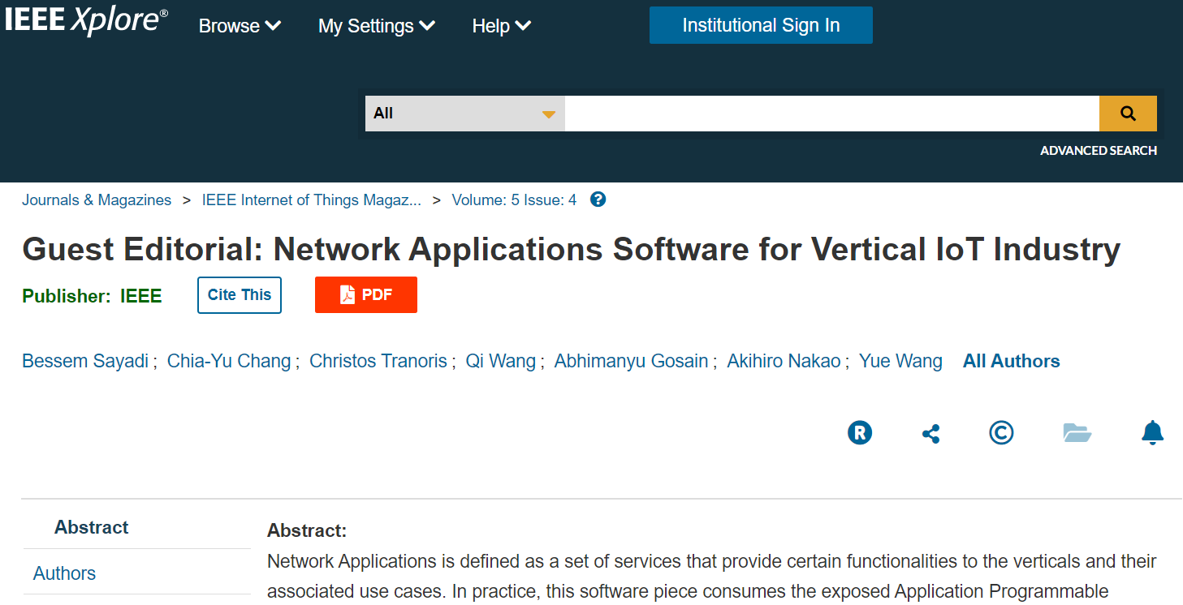

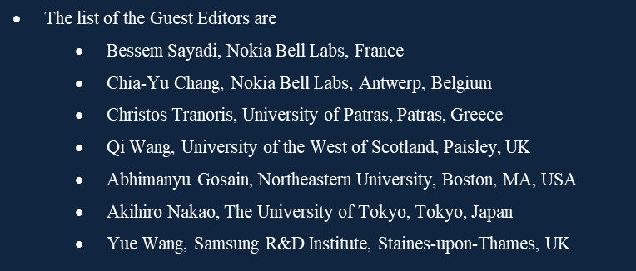
Dissemination
Cloud Native workshop serie in EuCNC
Special Sessions
  E.g. Network Exposure in EuCNC 2023
Special Issue publication (Comsoc, ACM)
Webinars
Joint Workshop with other WG

Slide 7
Lessons Learned
Reinforce the visibility of the outcomes like the white papers through participation in international events
Cross-WG collaboration should be strengthened by joint work in some white papers, e.g.
  Business analysis
  Security
  etc
Projects should be more engaged: identify the expert, report what it is on-going to your projects, formalize it in the DoA
Think beyond the funded project

Slide 8
Way forward
The plan is:
Network Applications V2, finalization and release in EUCNC 2023
Further dissemination activities: potential EuCNC 2023 Special Session related on Network Exposure, EuCNC 2023 convened session proposal on 5GPPP outcomes and impact generated
Transition of the SN WG to SNS JU as of Sept/Oct 2023 since cloud native, multi-stakeholder orchestration across heterogeneous domains including extreme edge, platform abstraction, exposure, data layer, 6G service delivery framework etc are key for 6G. There is a lot to do.

Slide 9
Thank you for your attention!

