Slide 1


5GPPP 5G/B5G Architecture WG
Scope, Road So Far, & Way Forward
25 May 2023, 5GPPP to SNS JU: Passing the Torch Event
Dr. Ömer Bulakci
oemer.bulakci@nokia.com
5GPPP Arch WG Chair, Nokia
Dr. Xi Li
xi.li@neclab.eu
5GPPP Arch WG Vice-chair, NEC

Slide 2


Architecture WG Scope
5GPPP
Initiative
Architecture WG is one of the Working Groups as part of the 5GPPP Initiative
Brings 5GPPP projects together to attain the European View on the Overall Architecture & the Network Domains
Novel
Trends
Provides a consolidated view on the technical directions and concepts for the architecture design for 5G and beyond Networks
Key Tech.
Enablers
Architecture WG periodically releases White Papers that summarize the state-of-the-art architectural solutions stemming from the 5GPPP projects
5GPPP Architecture White Paper issued in June 2016 (v1.0) & updated in January 2018 (v2.0) based on Phase I projects’ results
Release (v3.0) issued during the EuCNC 2019 based on Phase II & Phase III projects’ results
Release (v4.0) issued in October 2021 based on Phase III projects’ results (ICT 17-20 Projects, ICT 41-42 projects, ICT 52- 53 projects) → 45 Projects have participated (max # of projects in the history of the WG)
V1.0 released June 2016
Novel trends and key architectural enablers for 5G vision
V2.0 released Jan. 2018
Key architectural findings and overall architecture definition
V3.0 released Feb 2020
Architecture enhancements and verticals-enabled architecture
V4.0 released October 2021
Consolidation of large-scale vertical trials and beyond 5G concepts
V6.0* Released for Public Consultation in Dec 2022 & Final Version in Feb 2023
Sets the foundation of the 6G Architecture Design, e.g., based on inputs from ICT 52 projects.
Concise Version, where the detailed version to be published as an open access book in June 2023.
*) Next version after v4.0 is deliberately put as v6.0 in relevance with 6G focus.
5GPPP Architecture White Paper Releases: https://5g-ppp.eu/white-papers/
Top Downloads from www.5g-ppp.eu [To-Euro-5G D3.2 July 2019]

Slide 3
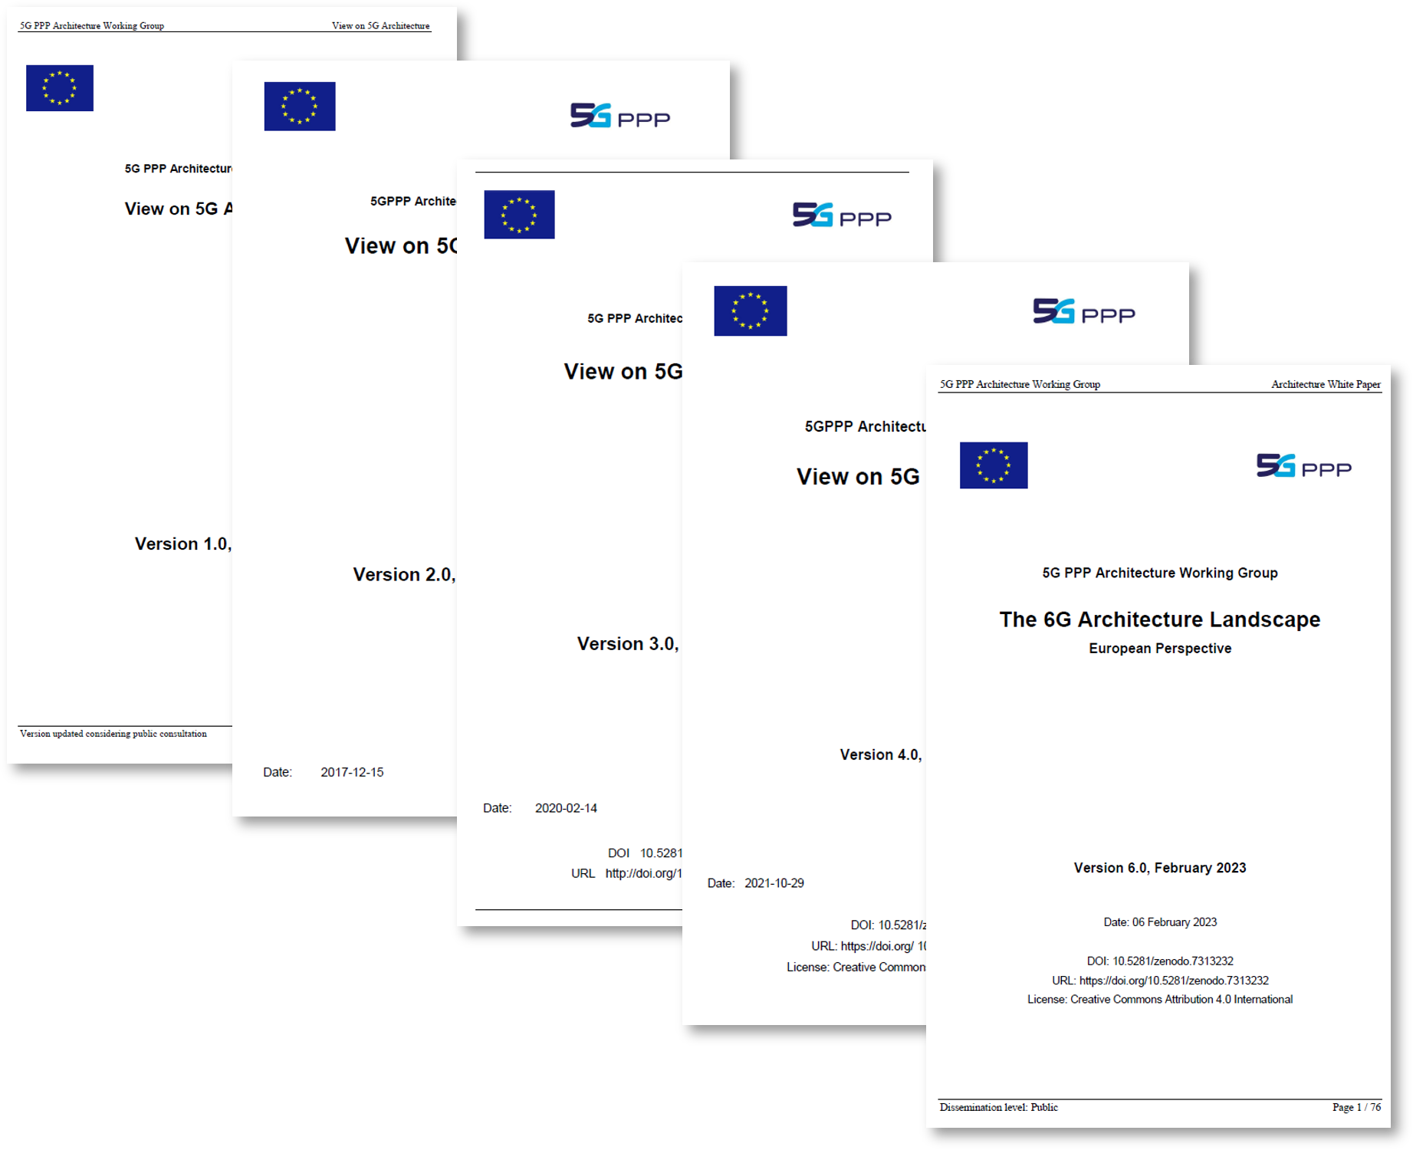
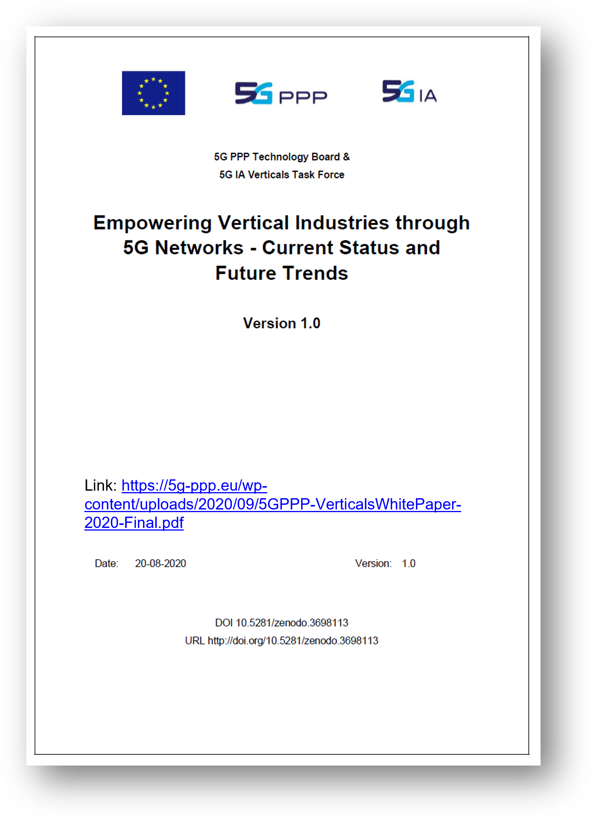


Architecture WG: Road so Far (Impact)
Five White Papers so far
Wide Participation from 5GPPP
1
White Papers by Arch WG
Network Architecture
2
5GPPP Collaboration
Supporting other 5GPPP Initiatives
White Papers & Dissemination thereof
3
WG Dissemination
Workshops & Special Sessions
Webinars
4
5GPPP Disseminations
Webinars
Bilateral Workshops, e.g., with Next GA
Collaborative Platform
Global Footprint
Cross-5GPPP Dissemination & Exploitation
3
Notes:
Own White Papers
Supporting 5GPPP Initiative White Papers
Workshops, Webinars, Special Sessions
Cross-5GPPP Dissemination & Exploitation

Slide 4
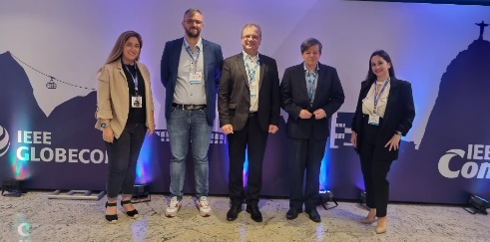


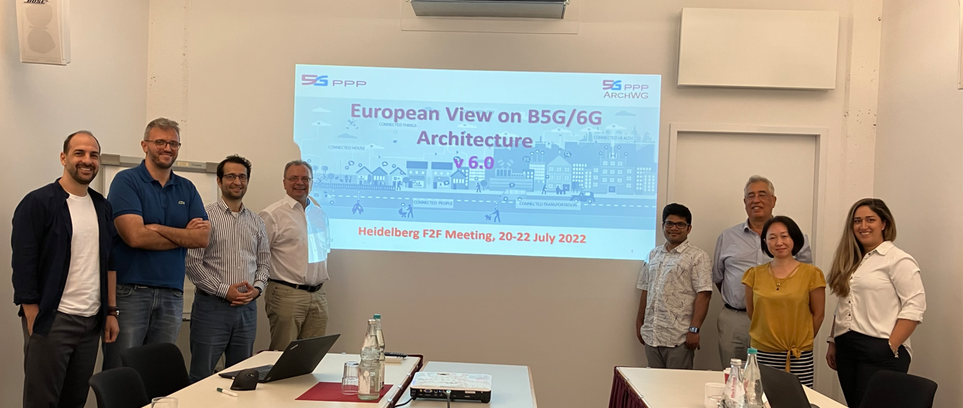

Architecture WG: Road so Far (Recent Dissemination)
White Paper v6.0
The 6G Architecture Landscape - European perspective
Focus on B5G/6G
5GPPP Projects with relevant focus (ICT 20 & ICT 52) as well as 5G projects with future looking innovations
Public Consultation version released (Globecom 2022)
Final version released in Feb 2023
Rest of the chapters to be published in the 6G book
F2F Meeting in Heidelberg 2022
Further Dissemination
Globecom WS 2022 “Architectural Evolution toward 6G Networks – 6GArch,” successfully concluded
Arch WG white paper v4.0 presentation at the Global 5G Event “5G Architectural Evolution: A European Perspective”
IEEE ComMag based on white paper v4.0 and extensions for Network Applications
NextGA-6G IA/IMT2030 PG Joint WSs for info exchange & future collaboration
6G Book
Open Access
Joint editorships with Hexa-X
Prefaces by EC and 6G-IA
Target completion in H1 2023, to be published in June along with EuCNC
Chapters
  Introduction
  Architecture Landscape
  Towards Versatile Access Networks
  Towards Joint Communications and Sensing
  Towards Natively Intelligent Networks
  Towards Sustainable Networks
  Towards Continuously Programmable Networks
  Secure, Privacy-Preserving, & Trustworthy Networks
  6G Outlook and Timeline
4

Slide 5
Architecture WG: Road so Far (Lessons Learned)
1 | Awareness
 | Various Projects in different Calls: Difficult to track WGs foster for cross-project collaboration
2 | Consolidation
 | Challenging task to consolidate diverse set of topics Initiate as early as possible to align and adapt subjects
3 | Dissemination
 | White Papers have been very successful Disseminate via international events & establish a series instead of single occurrences
4 | Book
 | Has been very challenging considering new set of requirements and design concepts Plan early enough, secure the budget, and streamline the efforts for Max impact, e.g., Arch WG & Hexa-X
5 | Cross-WG Collaboration
 | Has been varying depending on the calls & timeline Could be further strengthened
6 | Global Footprint
 | Bilateral workshops via research for a have been very beneficial Consider having 6G-IA members (non-voting) also at Programme Initiative WGs

Slide 6
Architecture WG: Way Forward
Arch WG has been excelling at
  bringing the projects together to attain the European View on the Overall Architecture & the Network Domains
  providing a consolidated view on the technical directions and concepts for the architecture design for 5G & Beyond Networks
Milestones:
  M1: Various inputs have been received based on the Public Consultation version from Dec 2022 & being processed → the most # of inputs received in the history of the WG
  M2: Final version to be released within Feb 2023 → Covers concise version of the white paper with focus on overall architecture for 6G landscape, including the current technology and society trends, and key architecture enablers
  M3: Detailed version to be published as an open access book in June 2023 → Covers overall architecture as well as the detailed chapters focusing on various 6G architecture topics. Sets the architectural foundation.
  M4: Transition the WG to the SNS JU framework, e.g., update the Terms of Reference (ToR), change the focus to SNS projects, and align the WG scope accordingly. Potential completion date ~ Sept 2023.
M1
M2
M3
M4
V6.0 Public Consultation
Dec 2022
Foundation of 6G Arch
Inputs are addressed
V6.0 Final Release
Feb 2023
Overall Arch Chapter
6G Book
EuCNC 2023, June 2023
Detailed Version & Open Access
Transition of the WG into SNS
Updated ToR
SNS JU Projects to be onboarded
H1 2023
H2 2023

Slide 7
Thank you for your attention
For more information about 5G PPP activities please visit https://5g-ppp.eu
The white papers are available at https://5g-ppp.eu/white-papers/
7

Slide 8

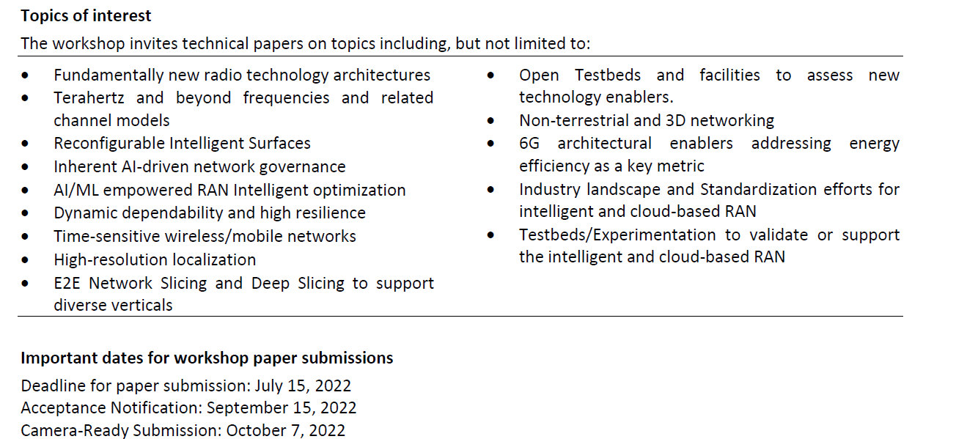
Globecom 2022 WS: 6GArch
2nd Workshop on Architectural Evolution toward 6G Networks – 6GArch
More information
https://globecom2022.ieee-globecom.org/workshop/ws21-2nd-workshop-architectural-evolution-toward-6g-networks-6garch
Technical Programme Committee
https://globecom2022.ieee-globecom.org/workshop/ws21-2nd-workshop-architectural-evolution-toward-6g-networks-6garch/committees
8

Slide 9


5GPPP Architecture WG Latest Participants (1/3)
5GPPP Architecture WG re-started the work in Oct 2020 with the inclusion of 5GPPP Projects (ICT 17-20 Projects, ICT 41-42 projects, ICT 52- 53 projects)
5G PPP Phase 3, Part 1:
Infrastructure Projects
5G-PPP ICT-17-2018 call
Implementing and testing advanced 5G infrastructures in Europe
5G PPP Phase 3, Part 2:
Automotive Projects
5G-PPP ICT-18-2018 call
Implementing and testing advanced cross-border 5G infrastructures in Europe
5G PPP Phase 3, Part 3:
Advanced 5G validation trials across multiple vertical industries
5G-PPP ICT-19-2019 call
Get the European 5G Vision of “5G empowering vertical industries” closer to deployment.
9
Notes:
Timeline for 2021

Slide 10
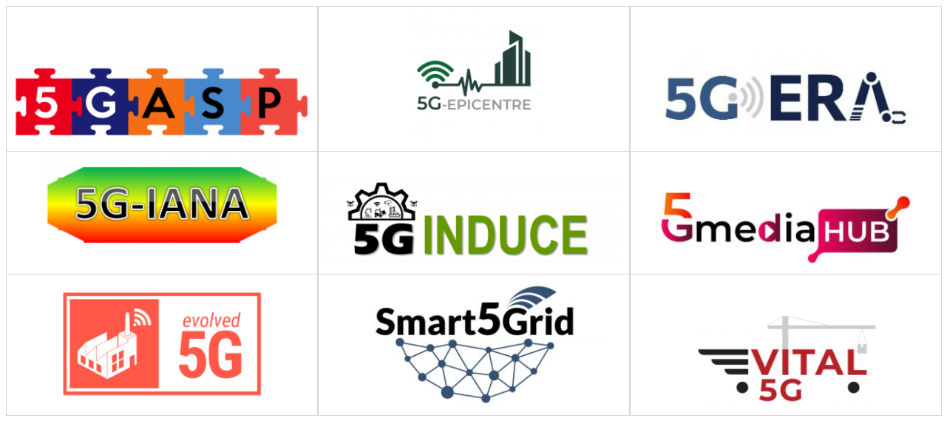




5GPPP Architecture WG Latest Participants (2/3)
5GPPP Architecture WG re-started the work in Oct 2020 with the inclusion of 5GPPP Projects (ICT 17-20 Projects, ICT 41-42 projects, ICT 52- 53 projects)
5G PPP Phase 3, Part 6:
5G innovations for verticals with third party services
5G-PPP ICT-41-2020 call
Verticals with 3rd party services
5G PPP Phase 3, Part 5:
5G Core Technologies innovation and 5G for Connected and Automated Mobility (CAM)
5G-PPP ICT-42-2020 call (5G Core Technologies innovation)
5G-PPP ICT-53-2020 call (5G for CAM)
Notes:
Timeline for 2021

Slide 11


5GPPP Architecture WG Latest Participants (3/3)
5GPPP Architecture WG re-started the work in Oct 2020 with the inclusion of 5GPPP Projects (ICT 17-20 Projects, ICT 41-42 projects, ICT 52- 53 projects)
5G PPP Phase 3, Part 4:
5G Long Term Evolution
5G-PPP ICT-20-2019 call
Longer Term Vision
Realization of pervasive mobile virtual services
5G PPP Phase 3, Part 6:
Smart Connectivity beyond 5G
5G-PPP ICT-52-2020 call
Smart Connectivity beyond 5G
Foundation of B5G/6G System
System Flagship Project & Complementary smaller and more focused projects
11
Notes:
Timeline for 2021

Slide 12

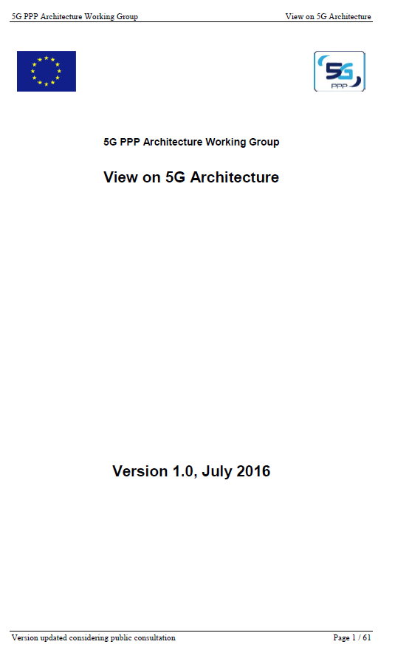
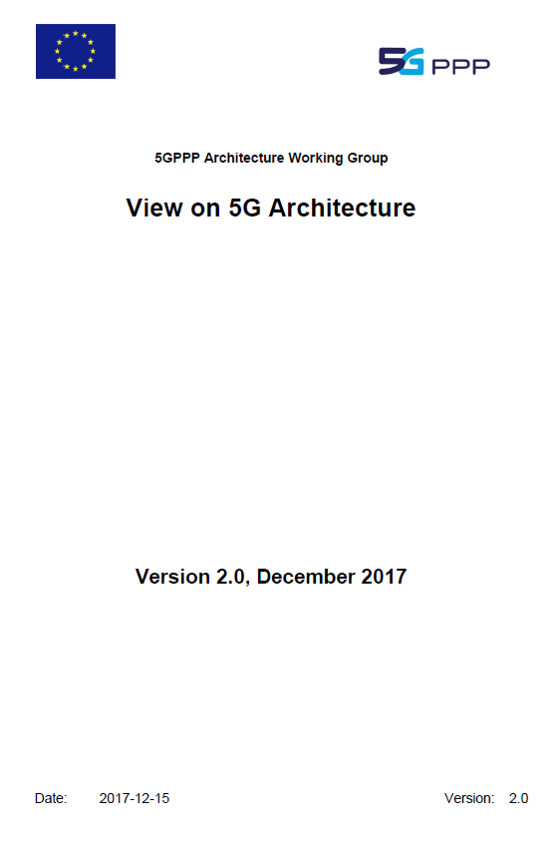
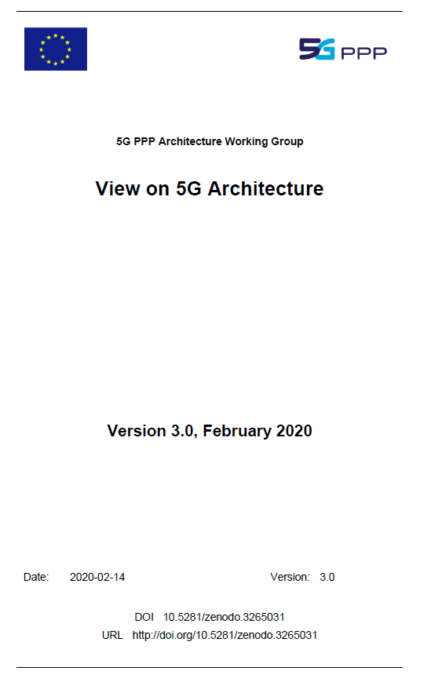

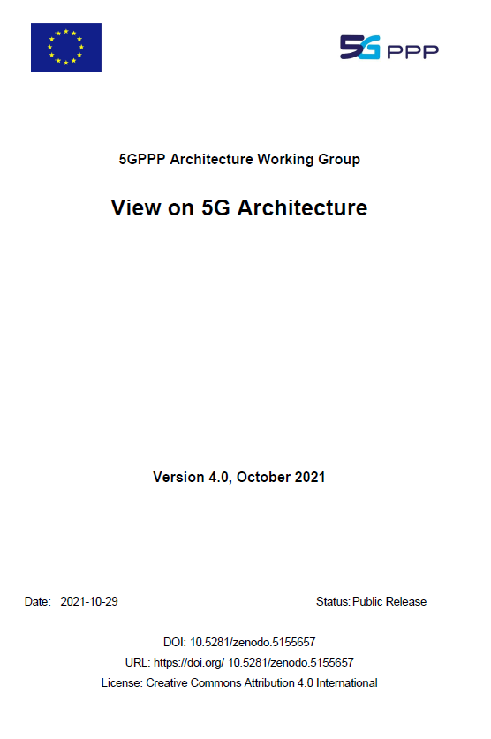
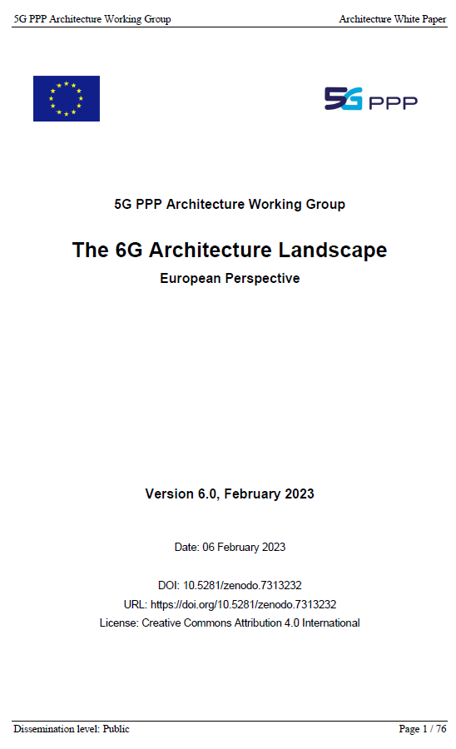
White Papers & Events
5GArch 2019:
International Workshop on 5G Architecture
Workshop on “ARCHITECTURAL EVOLUTION TOWARD 6G NETWORKS: A EUROPEAN VIEW”
12

