Slide 1
Technology Board
Passing the Torch
Dr. Mikael Fallgren
Ericsson Research
May 25th 2023

Slide 2
5G-PPP Technology Board
Membership – project leads for all active projects
  PL’s for expired projects are invited to ‘observe’.
  By invitation other entities can join occasionally to share information.
Role – technical co-ordination of cross-project activities
  Platform for technical discussions. To share and learn, to identify opportunities, and to drive selected TB activities forward.
  Co-ordinate efforts with SB to handle opportunities and challenges.
Current status – graceful retirement
  TB will close before the end of 2023.
  SB+TB preparing a whitepaper to capture achievements of 5G-PPP as a whole, and reflect on the mission at the outset.

Slide 3

Transferrable Best Practise
Guidance to Projects
Co-operation in a ‘safe space’
  Enable co-operation through periodically reoccurring TB meetings. Keep main contact point(s) to each project visible and up to date.
  Discuss identified opportunities and take actions. Is it an activity within TB? Is it broader than TB? Is it outside of TB? Interact with SB and Working Groups. For any TB activity, identify driver(s) and contributors.
Good things happen when we co-operate, for example
  Reference Figures, Key Achievements, Cartographies and Whitepapers.
  Contribute to other relevant work that, e.g., is taking place in Working Groups (WGs) and in Coordination & Support Actions (CSAs).
  “Publicise what you are doing – commonality in agenda is widespread and collaboration opportunities are there for the taking.
Push your project partners to sign the Collaboration Agreement so you can get involved ASAP!”

Slide 4

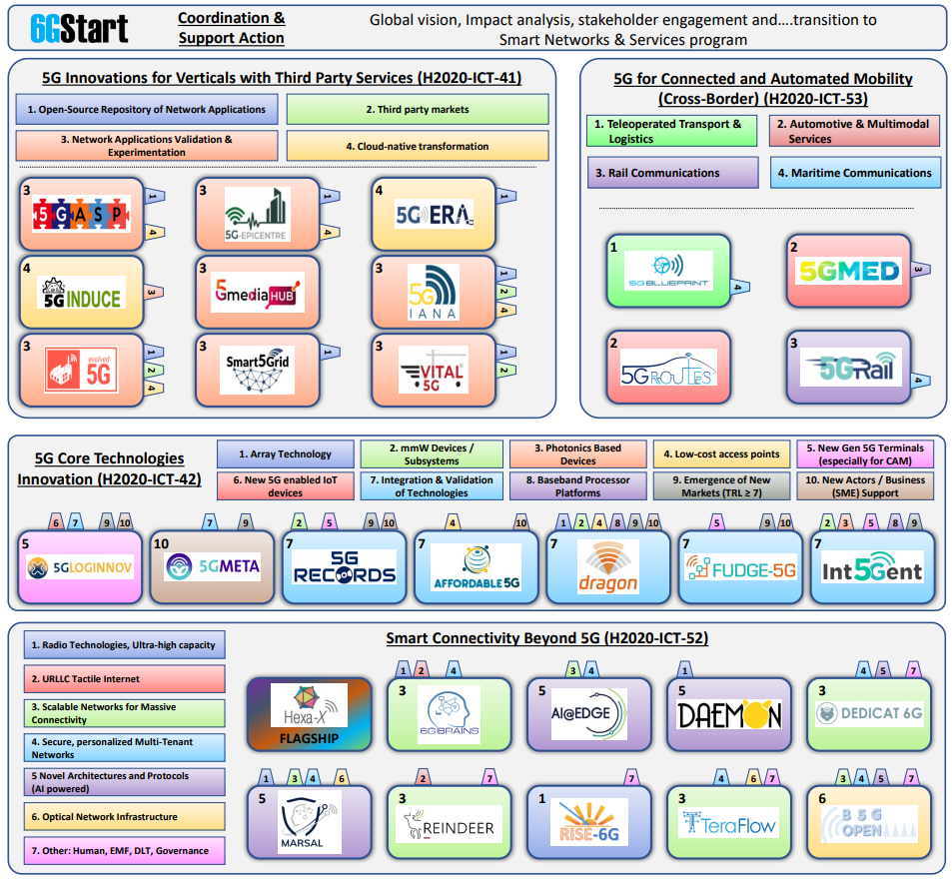
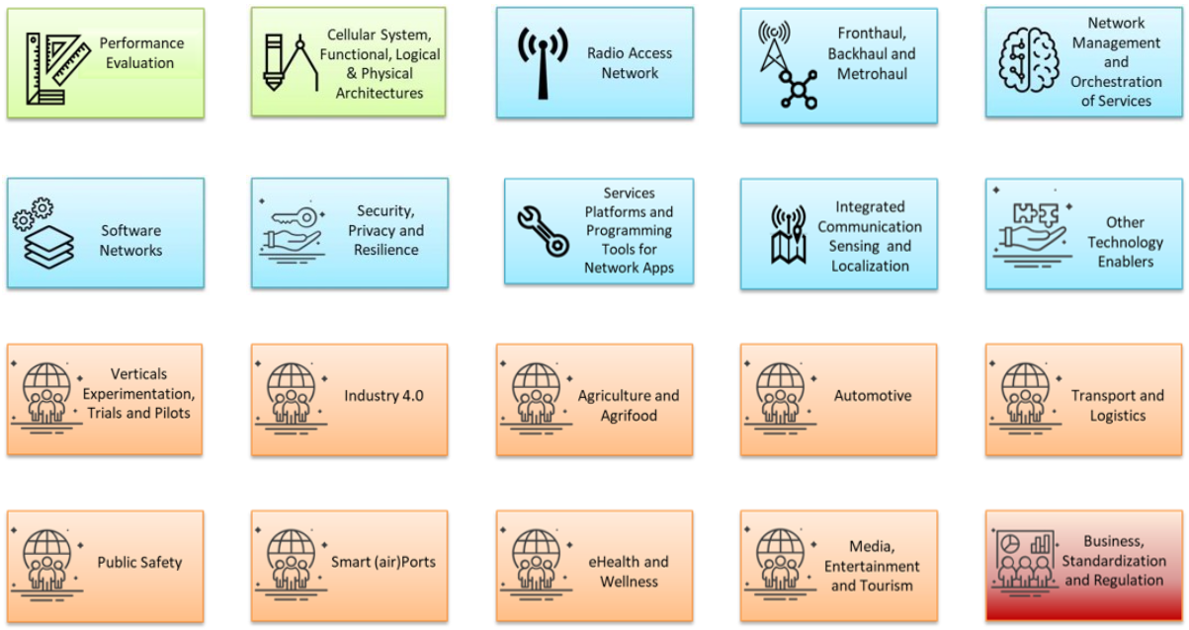
Examples
Reference Figure
https://5g-ppp.eu/5g-ppp-reference-figure-2023/
Key Achievements v3.2
https://5g-ppp.eu/phase-3-key-achievements-3-2/
5G-PPP whitepapers (https://5g-ppp.eu/white-papers/)
  TB: Non-Public-Networks – State of the art and way forward, Nov. 2022.

Slide 5
Finding the path ahead
Every new journey is different, make the best out of this one
Be open to, search for, and create opportunities together
  Build a solid foundation
    Active participation in TB. Collaborative environment with high visibility to be gained while high project load is a challenge. Dedicate project resources for TB.
    Establish good working relations within TB.
    Establish good working relations with SB and WGs.
    Establish other relevant connections and relations.
  Be involved by bringing contributions to the evolving research agenda.
  Time resources are limited, be ready to prioritize and focus the efforts.
  Stay engaged, rise to the challenging curve balls, build solutions.
SNS-JU TB has the opportunity to write its own formula.

Slide 6
Good luck to the SNS-JU
Technology Board!

