Slide 1
CAICV ICV Future Requirements
Hu Jinling
CATT

Slide 2
CSAE/ CAICV Overview
General Objectives
ICV Future Requirements
CONTENTS

Slide 3
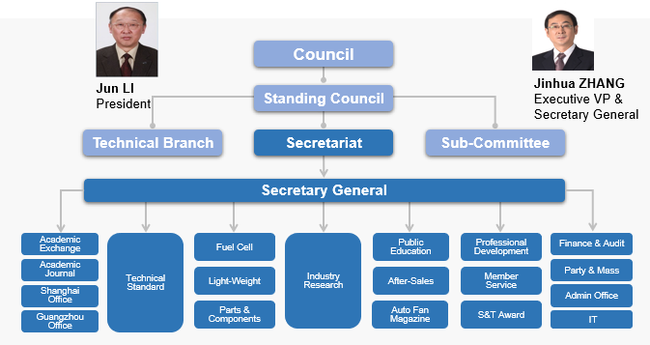
CSAE
China Society of Automotive Engineers (China-SAE or CSAE), a national academic organization, was founded in 1963, the secretariat is set up in Beijing.
CSAE has more than 70，000 individual members, mainly for automotive science and technology engineers.
CSAE’s main services include academic exchange, automotive policy research, collaborative innovation, talent training, technical standards.
Individual members：
Registered members：
Unit members：
70,000+
110,000+
1,900+

Slide 4
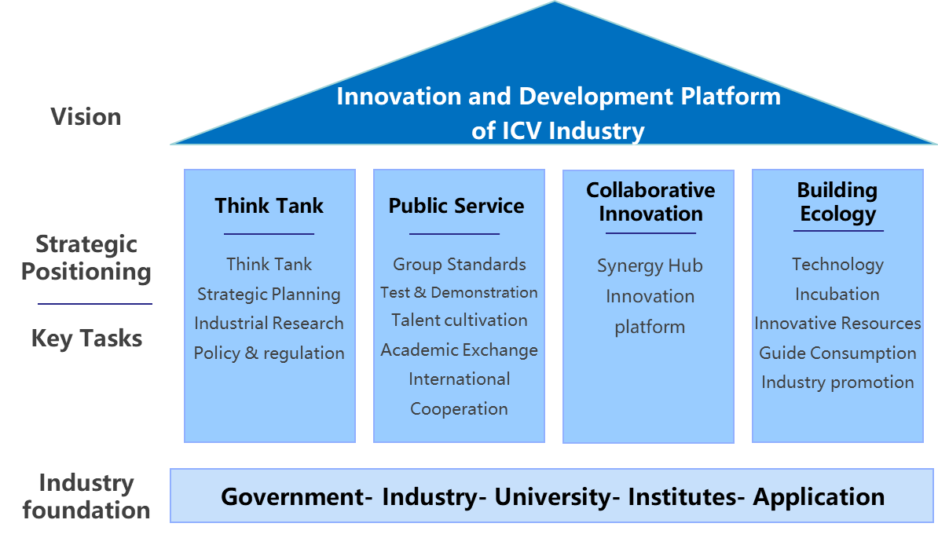


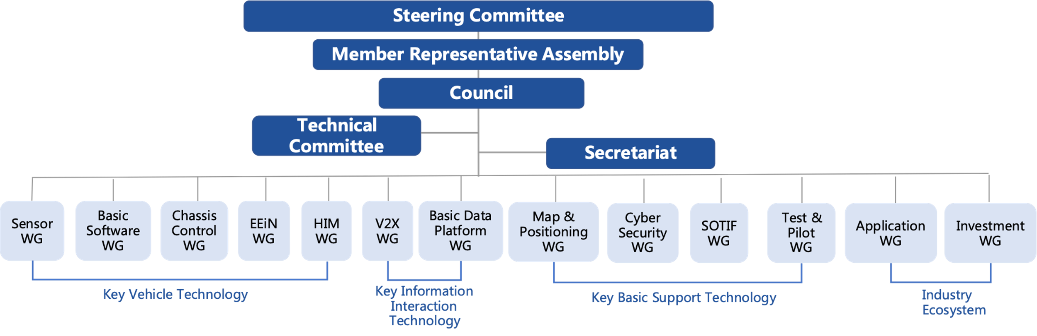
CAICV
China Industry Innovation Alliance for the Intelligent and Connected Vehicles (CAICV) was initiated by China SAE and the China Association of Automobile Manufacturers (CAAM), with the support of MIIT on June 12, 2017.
CAICV has more than 500 members, including companies, universities, and institutes from the automotive, telecommunication, transportation, and internet industries.
CAICV has 13 working groups for different technical fields.
Jun Li
Chairman
Keqiang Li
Director of Technical Committee

Slide 5




Vision & Mission
    Build an important innovation and development platform for China's ICV industry
Industry lead
World-renowned
professional
think tank
Public Service
World-renowned
group standard body
Collaborative Innovation
World-renowned ICV Innovation Center
Industry Ecosystem
Build
ICV ecosystem

Slide 6
Visions of ICVs
China will achieve the grand goal of building an automobile power, to drive the mobility of society towards a direction of sustainability, and to meet the people's expectation for a better life.
This is demonstrated by safety, efficiency, energy conservation, emission reduction, comfort and convenience and user-friendliness.
Efficiency
Significantly improve the operating efficiency of transportation and cities.
Energy conservation and emission reduction
Safety
Significantly reduces the number of traffic accidents and casualties.
Comfort and convenience
Improve driving comfort and make the driver feel relaxed.
User-friendliness
Enable the elderly and the disabled to travel.

Slide 7
General Objectives of ICVs
By 2025,
  level 2 & level 3 ICVs account for more than 50% of the new cars.
  level 4 ICVs begin to enter the market.
  The C-V2X terminal equipment rate for new vehicles reaches 50%.
  The connected collaborative perception technology is to be applied in some scenarios incl. highways, some urban roads and closed areas
By 2030,
  level 2 & 3 ICVs account for more than 70% of the new cars.
  level 4 ICVs is 20%.
  new vehicle equipped with C-V2X terminal is popularized
  vehicle-road-cloud integrated ICV with the collaborative decision-making will enter the market.

Slide 8
Levels of Automation and Connectivity
The classification method of integrating automation and connectivity is proposed, with 5 levels of automation and 3 levels of connectivity. The fully autonomous Driving will be realized by the convergence of automation and connectivity.
Connected Collaborative
Decision and Control
（LEVEL 3）
Connected Collaborative
Perception
（LEVEL 2）
Current vehicles are approaching automation level 3 (Conditional Automation) and connectivity level 2 (Connected Collaborative Perception).
Connected Auxiliary Information Interaction
（LEVEL 1）
Partial Driving Assistance
DA
Combined Driving Assistance
PA
Conditionally Automated Driving
CA
Highly Automated Driving
HA
Fully Automated Driving
FA

Slide 9
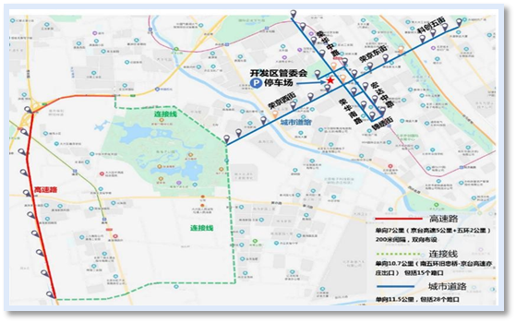
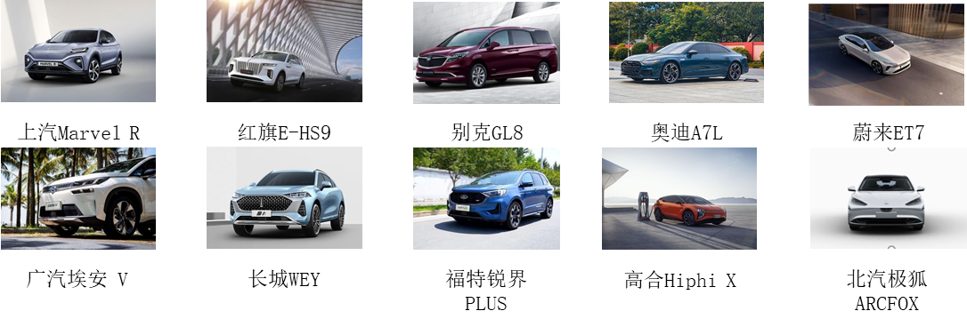

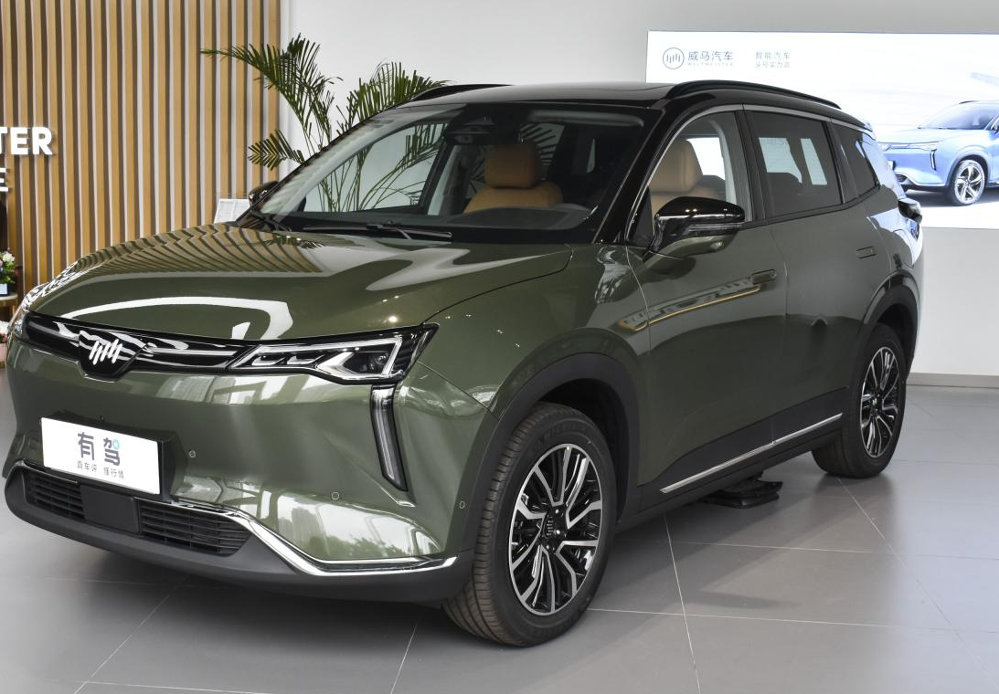
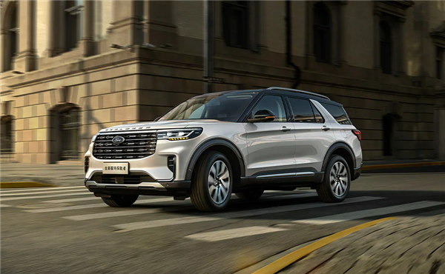
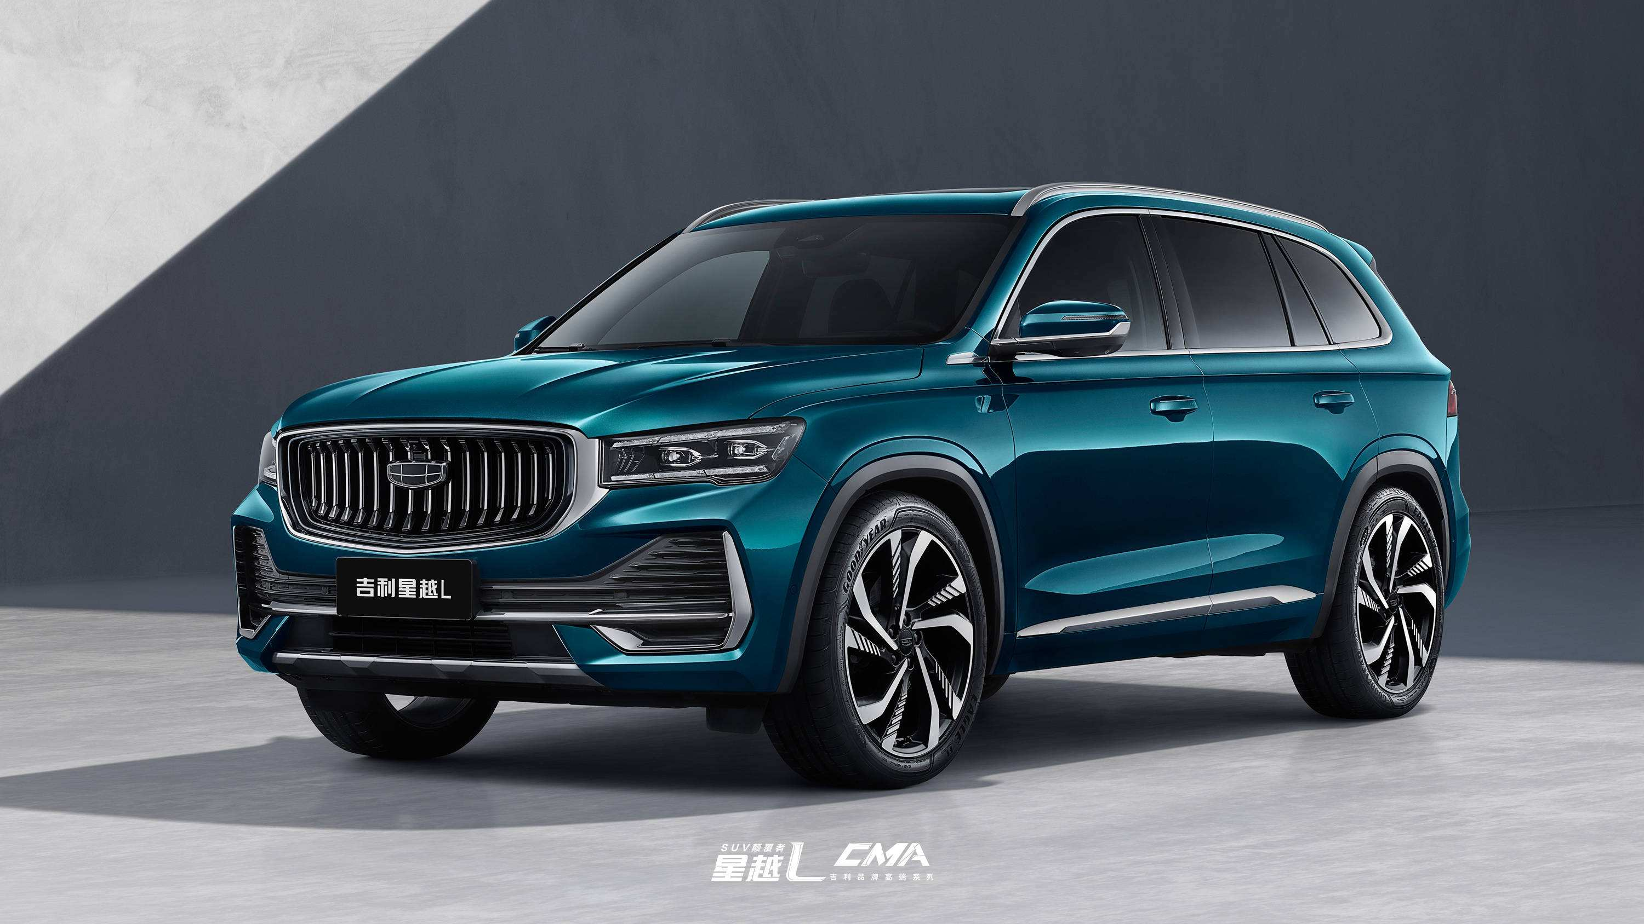
China C-V2X Industry Developments
C-V2X Infrastructure Takes Shape
Vehicles Announced Equipped with C-V2X
Test & Verification Activity
17 National ICV Demonstration Areas
4 National IoV Pilot Areas
16 Smart Infrastructure & Smart Vehicle Pilot Cities
上汽通用 GL8Avenir
威马W6
福特探险者
吉利星越L

Slide 10
Obstacles Impeding Industry
Infrastructure side
Roadside infrastructure need time & money to build or upgrade
C-V2X deployments need to be improved, RSU coverage especially for intersections and important sites
Reliable information can be accessed , for example Traffic light, dynamic road info…
Vehicle side
Long lifecycle , need more time to introduce new feature
OBU penetration need to be improved
Evaluation system for communication component
Killer application ?
Business model need to be explored
and need more collaboration across different stakeholders

Slide 11
ICV Application Evolving : C-V2X Day 1 & Day 2 Applications
T/CSAE 53-2020 Cooperative intelligent transportation system-Vehicular Communication application layer specification and data exchange standard(Phase I)
No. | Application name
1 | Forward Collision Warning
2 | Intersection Collision Warning
3 | Left Turn Assistant
4 | Blind Spot Warning / Lane Change Assist
5 | Do Not Pass Warning
6 | Emergency Brake Warning
7 | Abnormal Vehicle Warning
8 | Control Lost Warning
9 | Hazardous Location Warning
10 | Speed Limit Warning
11 | Signal Violation Warning
12 | Vulnerable Road User Collision Warning
13 | Green Light Optimal Speed Advisory
14 | In-vehicle Signage
15 | Traffic Jam Warning
16 | Emergency Vehicle Warning
17 | Vehicle Near-field Payment
YD/T 3977-2021 The requirements standard for enhanced V2X application layer data interaction
No. | Application name
1 | Vehicle Merging
2 | Vulnerable Road User Recognition
3 | Intersection Crossing based on Vehicle-infrastructure Cooperation
4 | Vehicle Route Guidance
5 | Dynamic Lane Management at Intersection
6 | Dynamic Optimization of Traffic Signal Timing based on Real-time Connected Data
7 | Intelligent Parking Guidance
8 | Vehicle Platooning Driving
9 | Cooperative Platooning Management
10 | Flexible Management of Expressway Dedicated Lane
11 | Active and Passive Tolling based on Vehicle-infrastructure Cooperation
12 | Dynamic Path Planning of Electric Vehicle
13 | Remote Software Upgrade based on Vehicle-infrastructure Cooperation
14 | Hardware In-the-loop Simulating of Automated Vehicle based on Vehicle –Infrastructure Cooperation
T/CSAE 157-2020 Cooperative intelligent transportation system-Vehicular Communication application layer specification and data exchange standard(Phase II)
No. | Application name
1 | Sensor Data Sharing
2 | Cooperative Lane Change
3 | Cooperative Vehicle Merge
4 | Cooperative Intersection Crossing
5 | Differential Data Service
6 | Dynamic Lane Management
7 | Cooperative High Priority Vehicle Passing
8 | Guidance Service In Parking Area
9 | Probe Data Collection
10 | Vulnerable Road User Safe Passing
11 | Cooperative Platooning Management
12 | Road Tolling Service
T/CSAE 158-2020 (YD/T 3978-2021) Data exchange standard for high level automated driving vehicle based on cooperative intelligent transportation system
No. | Application name
1 | Cooperative Perception
2 | Non-signalized Intersection Crossing based on Roadside Cooperation
3 | Cooperative driving for Automated vehicle out of stuck
4 | High-precision Map Version Alignment and Dynamic Update
5 | Cooperative Automated Valet Parking
6 | Cooperative detection of “Zombie car”
7 | Cooperative detection of traffic situation
8 | Cooperative detection of abnormal driving behavior

Slide 12
Communication Evolution from 5G to 6G
U-eMBB
Upgrade eMBB
1）、More powerful network capability
Rich Scenarios mMTC
Deterministic
URLLC
2）、New service capability
R-mMTC
D-uRLLC
Hotspot Short -Range Coverage
3）、New coverage Scenarios
Wide-area Full Coverage
Sensing & Positioning
Computing & Intelligence

Slide 13
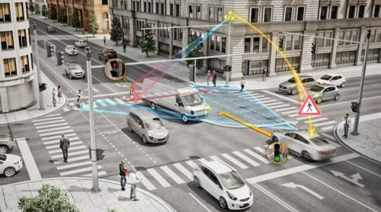
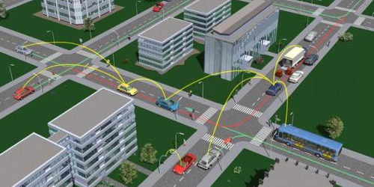
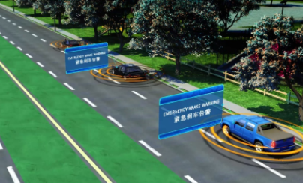
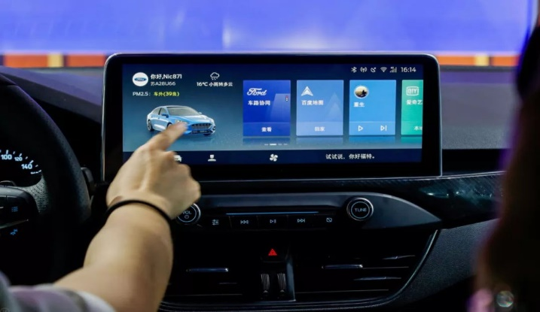
ICV Applications Specific Requirements
Road Safety | Traffic Efficiency | Automated Driving | Infotainment
Stringent | Fast Change | High Frequency | Complex Scenarios
Safety related ms level Reaction time | Relatives speed up to 500Km/h Burst Comm Topology Varying wireless channel | BSM, 10Hz BSM extension, PCM > =20Hz Multi to multi Comm | Highway， Urban，Suburban, Tunnel LOS, NLOS Out of coverage

Slide 14
Potential Connectivity Evolution for ICV
Robust and ubiquitous connectivity, high data rate and low-latency V2X capability are key to realize full automated driving
V2X Direct Communication enhancement
Native requirements of high precise positioning
Vehicular environment specific consideration ,such as antenna deployment
Joint communication and sensing
Vehicular sensors to help communication
Communication waveform help sensing
AI introduced in V2X communication

Slide 15

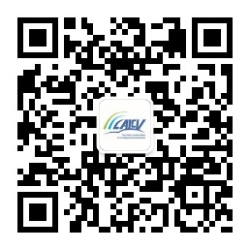

Thanks for Your Attention
CSAE
CAICV
CATT
http://www.sae-china.org/
http://www.caicv.org.cn/
https://www.gohigh.com.cn/

