Slide 1
Connection is the lifeline
Tero Pesonen
Vice Chair and CCBG Chair TCCA
24° November.2022

Slide 2
TCCA Vision
Empowering critical communications users for a safer society

Slide 3
TCCA Mission
Provide a platform for the exchange of information and experience between members
Drive the evolution of critical communications worldwide
Promote the critical communications market and solutions to a global audience.

Slide 4
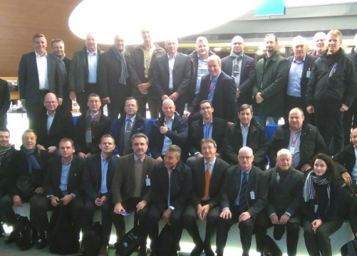
About us
We support open and standardised mobile critical communications technologies and complementary applications.
3GPP Market Representation Partner.
Catalysing competitive multivendor markets worldwide through open standards.
Our members include users, operators, industry and other stakeholders globally all sharing knowledge and experience.
Collaborative working across the critical communications ecosystem to develop and drive the most effective solutions for all.
Notes:
But first couple word about TCCA – The Critical Communications Association.
We have our roots in PMR digitalisation and standardisation over 25 years ago with development of the TETRA standard.
Ever since we have developed and enhanced our collective expertise in the requirements of critical users and now apply this in the critical broadband world.
We work closely with ETSI (Long lasting Cooperation agreement) and 3GPP, where TCCA is the Market Representation Partner for critical communications ecosystem.
From narrowband to critical broadband, our members come from all around the world, using TCCA as the focal point to channel collective knowledge, innovation and consultation to ensure the most efficient progress in standards and technology.

Slide 5
Core Critical Communications requirements

Slide 6
Coverage
Metropolitan – Urban – Rural, Population – Geographical

Slide 7
Availability
24/7/365

Slide 8
Resilience
Service in all circumstances

Slide 9
Performance
Instant service

Slide 10
Scalability
From single to massive

Slide 11
Functional suitability

Slide 12
Core Critical Communications requirements
Coverage
Availability
Resilience
Performance
Scalability
Functional suitability
Connection is literally the lifeline

Slide 13
Questions?
TCCA CCBG
https://tcca.info/broadband/critical-communications-broadband-group/
Find TCCA also on
LinkedIn
LinkedIn www.linkedin.com/company/tcca-critical-communications/
Facebook www.facebook.com/tandcca
Facebook www.facebook.com/tccacritcomms
Twitter @tandcca
Twitter @TCCAcritcomms
YouTube www.youtube.com/user/tandcca
YouTube www.youtube.com/user/tandcca
Tero Pesonen
TCCA Vice Chair & Director, CCBG chair
E-mail tero.pesonen@tcca.info
Mobile +358 50 544 7347
fi.linkedin.com/in/teropesonen
Notes:
This ends my presentation. In the handout I have included some extra material on TCCA and critical communication sector proposals for 3GPP Release 18.
Do we still have time for some questions?
Enjoy the rest of the conference – hopefully next time we can attend also in person.

