Slide 1
Horizon 2020
Call ICT 7 & ICT 8
5G PPP INFO DAY, Brussels
21 January 2016
Bernard Barani
European Commission – DG CONNECT
Deputy Head of Unit "Network Technologies"

Slide 2

Context
- 5G Public Private Partnership (PPP) under EU Horizon 2020 R&I programme. 5G PPP dedicated to 5G system
  Phase 1 ➔ Phase 2 of 5G PPP implementation
  Vision and technological requirements:
  http://5g-ppp.eu/wp-content/uploads/2015/02/5G-Vision-Brochure-v1.pdf
  Verticals papers, see 5G-PPP web site
  Working Groups
  Multiple side developments, standards, spectrum
  More than projects, a programme: use of contractual clause 41.4

Slide 3
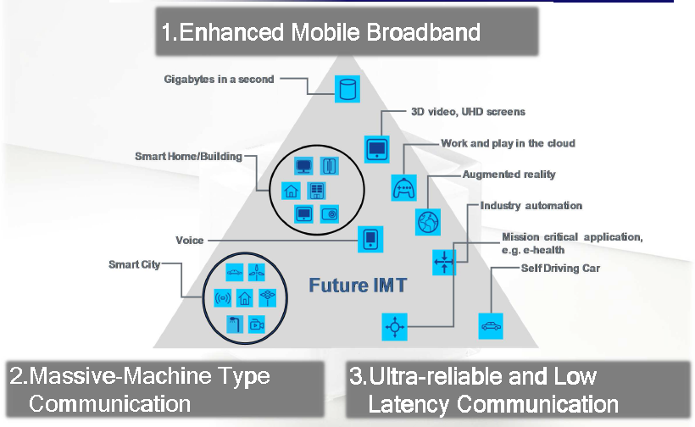
5G PPP Context

Slide 4
5G-PPP Context

Slide 5
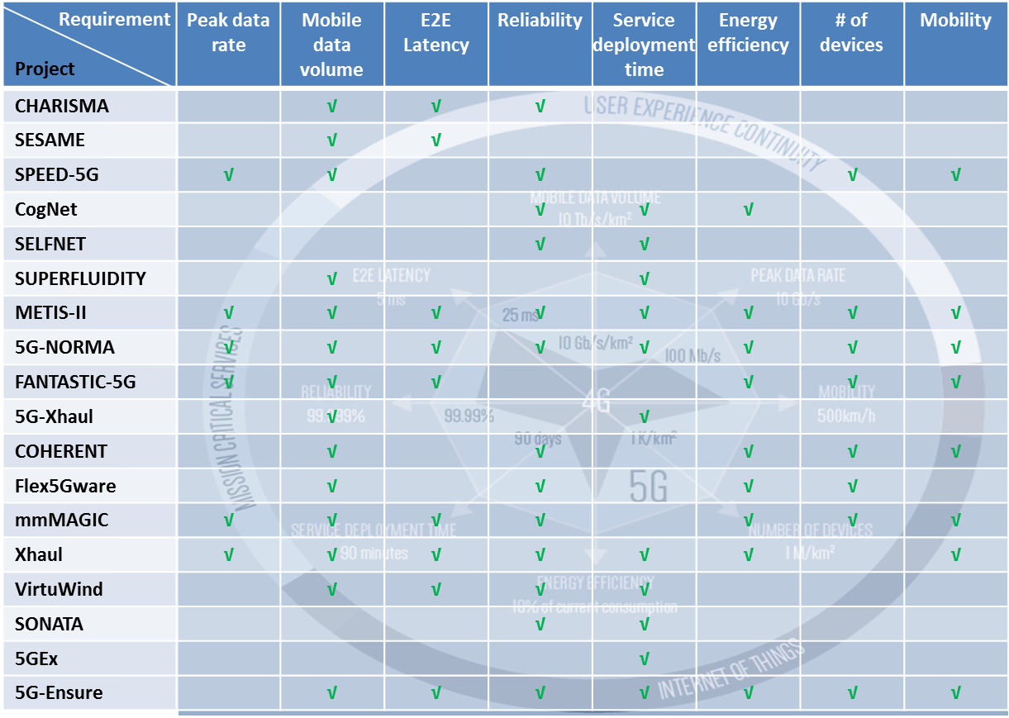
5G-PPP Context

Slide 6
ICT 7 – 5G PPP Research and Validation of critical technologies and systems
High level Objectives
To leverage work and results of phase 1 (WP 2014-15) and to accelerate on proof of concepts and demonstrators → 3GPP, WRC 19 milestones
To support a much wider array of requirement than today and with capability of flexibly adapting to different "vertical" application requirements
To cover a wide range of services from different use case and application areas/verticals, for increasingly capable user terminals, and for an extremely diverse set of connected machines and things
to support a shift from the “Client-Server” model to “Anything” as a Service (XaaS), no need to own HW/SW
Network elements will become "computing equivalent" elements that gather programmable resources, interfaces and functions based on virtualisation technologies
optimisation of cost functions (capex/opex) and of scarce resources (e.g. energy, spectrum), as well as migration towards new network architectures

Slide 7
ICT 7 – 5G PPP Research and Validation of critical technologies and systems a. Research & Innovation
100 M€
a.1. Strand wireless access and radio network architecture/technologies
Novel air interface technologies
Hardware architectures, building blocks
(Radio) Network functional architectures and interfaces leading to a reference architecture for 5G in support of the forthcoming standardisation work
Co-operative operation of heterogeneous access networks integrating virtual radio functions into service delivery networks
Support of numerous devices with different capabilities, with unified connectivity management capabilities, in terms of security, mobility and routing
Coordination and optimization of user access to heterogeneous radio accesses
Multi-tenancy for Radio Access Network (RAN) sharing, covering ultra-dense network deployments
Integration of Satellite Networks

Slide 8
ICT 7 – 5G PPP Research and Validation of critical technologies and systems a. Research & Innovation
a.2. Strand High capacity elastic - optical networks
Key: core and metro transport capacity/flexibility
New spectrally efficient, adaptive transmission, networking, control and management approaches to increase network capacity by a factor of >100
To provide high service granularity, guarantees for end-to-end optimization and QoS - reducing power consumption, footprint and cost per bit and maintaining reach
integration of such new optical transport and transmission designs with novel network control and management paradigms (e.g., SDN)
Notes:
Objective: high matching capacity from metro and core in support of het access.
Optical transport for metro and core

Slide 9
ICT 7 – 5G PPP Research and Validation of critical technologies and systems a. Research & Innovation
a.3. Strand Software Networks
Software network architecture to support an access agnostic converged core network and control framework enabling next generation services
A unified management of connectivity, with end to end security mobility and routing for flexible introduction of new services. Multi domain
Solutions (e.g API's and corresponding abstractions) that allow re-location or anycast search of services and their components
Scalability and efficiency related to increasing deployment of software-based network equipment and functions as well as corresponding more diverse services and usages
Realisation of the "plug and play vision” for computing, storage and network resources through appropriate abstraction, interfaces, and layering, targeting a Network Operating System (NOS), integration of exp facilities
Management and security for virtualised networks (incl. across multiple virtualised domains) and services to support service deployment decisions

Slide 10
ICT 7 – 5G PPP Research and Validation of critical technologies and systems b. Coordination and Support Actions
3 M€
Activities to ensure a sound programmatic view of the implemented 5G Research and Innovation Actions (RIA) and Innovation Actions (IA) results:
Programme level integration through management and orchestration of 5G PPP project cooperation for horizontal issues of common interests in support of the commitments of the 5G PPP contractual arrangement
Portfolio analysis, coverage, mapping and gap analysis, roadmaps
Support to the emergence of a 5G PPP "5G vision", to key international co-operation activities, SDO's, WRC..
Organisation of stakeholder events
Monitoring of the openness, fairness and transparency of the PPP process
Maintenance of the "5G web site"

Slide 11
ICT 7 – 5G PPP Research and Validation of critical technologies and systems
Expected Impact
RIA at macro level:
40% of the world communication infrastructure market for EU headquartered companies; Demonstrated progress towards core 5G PPP KPI's; EMF <LTE; Novel business models through innovative sharing of network resources across actors
RIA at operational level:
Flexibility of optical resource management; Optimised optical backhaul architectures and technologies; Ubiquitous 5G access, Definition of 5G network architecture, Proactive contribution to the standardisation activities on 5G, Proof-of-concept and demonstrators beyond phase one/specific use cases with verticals, Novel connectivity paradigms (edge), Network function implementation through generic IT servers, OS like capabilities to orchestrate network resources, Trustworthy interoperability across multiple virtualised operational domains and management of multi domain virtualised networks
CSAs:
Maximised output and exploitation of 5G PPP project results, Constituency building, stakeholder support, support to key international cooperation events; dissemination, Definition of future R&I actions

Slide 12
ICT 8 – 5G PPP Convergent Technologies
High level Objectives
To tackle scalability and usability of mixed network technological approaches that can benefit from previous research, towards validation of deployment at scale
For IAs: work draws on existing scientific and research results in the field and includes scalable demonstrators validated through typical usage scenario (s1); openness to 3rd party developers (S2)
For RIAs: collaborative research in 5G access leveraging Taiwan testbeds offers

Slide 13
ICT 8 – 5G PPP Convergent Technologies a. Innovation Actions
40 M€
a.1. Strand Ubiquitous 5G access leveraging optical technologies
to develop and assess new optical access network solutions based on integrated optical device prototypes
new optical transmission, switching and information processing techniques to support key access functionalities such as beam forming, high accuracy cm/mmWave generation and massive MIMO deployments
Co-operative radio-optical approaches
Techniques to map 5G channels to optical transport and a co-design of the optical and wireless interfaces and protocols
a.2. Strand Flexible network applications
targets development of a multiplicity of Virtualised Network Functions (VNF) for deployment of Network Applications
Targets a Cloud-like 5G infrastructures, supporting network services, resource and service orchestration
open source development framework for control functionalities and application development, open platforms to third parties

Slide 14
ICT 8 – 5G PPP Convergent Technologies b. Research and Innovation Actions
5 M€
Cooperation in access convergence
To take advantage of the supporting 5G research and demonstration facilities offered by Taiwan towards collaborative 5G research with the EU
Test beds making use of facilities offered by Taiwanese partners
Development and demonstration of an integrated convergent access across different air interface technologies and the fronthaul/backhaul/core network and capabilities of new spectrum access schemes
A system demonstrator showing applications potential is favoured

Slide 15
ICT 8 – 5G PPP Convergent Technologies
Expected Impact
Innovation Actions:
Validated access network architecture with integrated optical technologies for the realisation of critical access and transport control function
Demonstration of technological applicability to dense access scenarios
Demonstrated scalability, close to operational context. Contribution to standards, notably 5G and optical access
Optical access interface with 10 times lower energy consumption
Open environments for creation of network apps and Open repository of network apps that may be validated and leveraged by third party developers
Validation at scale of the VNF aggregation capability
RIA at operational level:
Contribution to the ITU-R objectives for the next generation mobile network
Contribution to the 1000 fold mobile traffic increase per area
Contribution to the 1ms latency objective
Results exploitation in the context of standardization and spectrum requirements

Slide 16

Call planning
ICT-07-2017 & ICT-08-2017:
Opening: 10 May 2016
Closing: 08 Nov 2016

Slide 17

Find out more
Horizon2020 web site
  http://ec.europa.eu/programmes/horizon2020
Participants portal
  http://ec.europa.eu/research/participants/portal
H2020 Helpdesk, including FAQ
  http://ec.europa.eu/research/index.cfm?pg=enquiries
5G PPP: http://www.5G-PPP.eu

Slide 18
Thank you for your attention!

Slide 19

5G-PPP links
5G research in FP7 and
in the private sector
5G PPP Phase I
5G PPP Phase II
5G PPP Phase III
Results from FP7
Projects contributed
to ITU-R on 5G vision
and requirements
3GPP Work Items and 3GPP Releases
3GPP Study Items
ONF, Open Daylight, OPNFV, Open Stack, …
ITU-R Vision and Recommendation
WRC preparatory process
Trials
Contributions to standardisation and regulatory process via member organisations in respective bodies
Prototype and product development
TIME
19

