Slide 1
Phase 1, running work and objectives
Info Day, Brussels, 21/01/2016

Slide 2
Horizon 2020 5G PPP
Call 1 selected projects
Research projects
5G Ensure
Security
Innovation projects
CogNet
Building an Intelligent System of Insights and Action for 5G Network Management
SELFNET
Framework for SELF-organized network management in virtualized and software defined NETworks
CHARISMA
Converged Heterogeneous Advanced 5G Cloud-RAN Architecture for Intelligent and Secure Media Access
SUPERFLUIDITY
Superfluidity: a super-fluid, cloud-native, converged edge system
5GEx
5G Exchange
VirtuWind
Virtual and programmable industrial network prototype deployed in operational Wind park
SONATA
Service Programming and Orchestration for Virtualized Software Networks
COHERENT
Coordinated control and spectrum management for 5G heterogeneous radio access networks
5G-Norma
5G NOvel Radio Multiservice adaptive network Architecture
METIS-II
Mobile and wireless communications Enablers for Twenty-twenty (2020) Information Society-II
SPEED-5G
quality of Service Provision and capacity Expansion through Extended-DSA for 5G
SESAME
Small cEllS coordinAtion for Multi-tenancy and Edge services
FANTASTIC-5G
Flexible Air iNTerfAce for Scalable service delivery wiThin wIreless Communication networks of the 5th Generation
5G-Xhaul
Dynamically Reconfigurable Optical-Wireless Backhaul/Fronthaul with Cognitive Control Plane for Small Cells and Cloud-RANs
Flex5Gware
Flexible and efficient hardware/software platforms for 5G network elements and devices
Xhaul
The 5G Integrated fronthaul/backhaul
mmMAGIC
Millimetre-Wave Based Mobile Radio Access Network for Fifth Generation Integrated Communications
Euro-5G
5G PPP Coordination and Support Action
Source: EURO-5G.

Slide 3
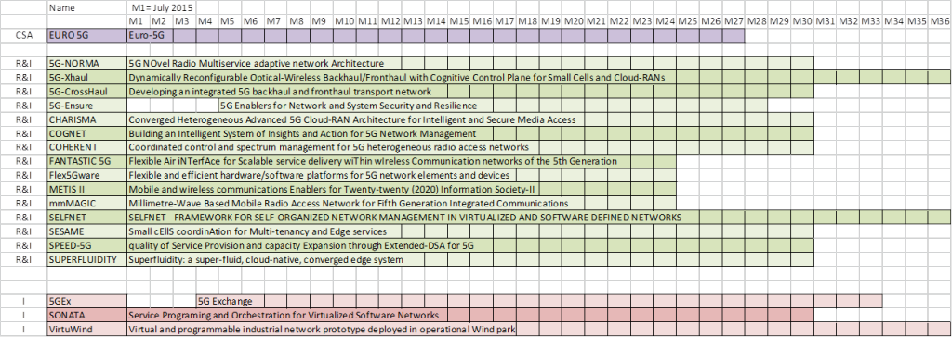
Phase 1 time plan

Slide 4
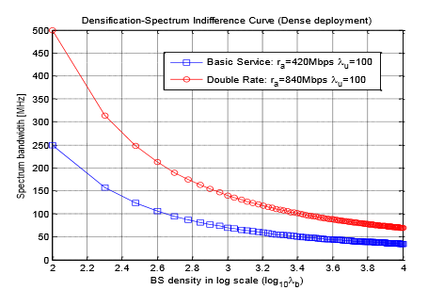
Examples of results
METIS II
Preliminary spectrum scenarios and justification for WRC Agenda Item for 5G bands above 6 GHz

Slide 5
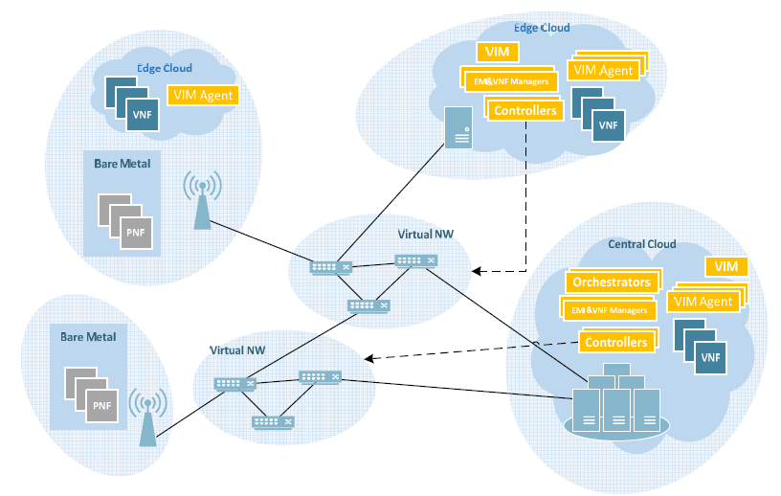
Examples of results
5G-NORMA
Functional Network Architecture and Security Requirements

Slide 6
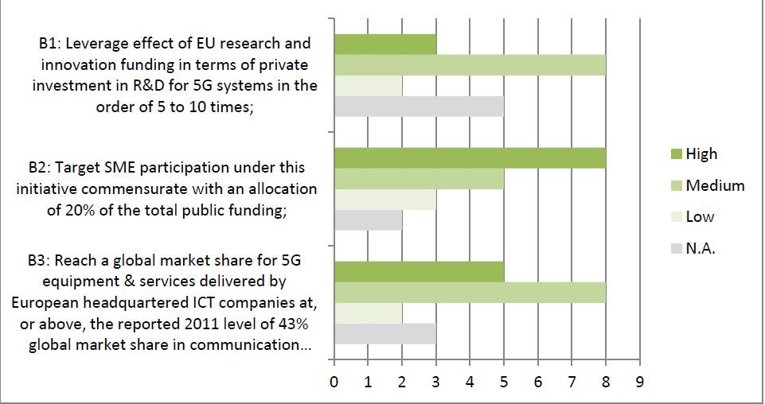
Business KPIs

Slide 7
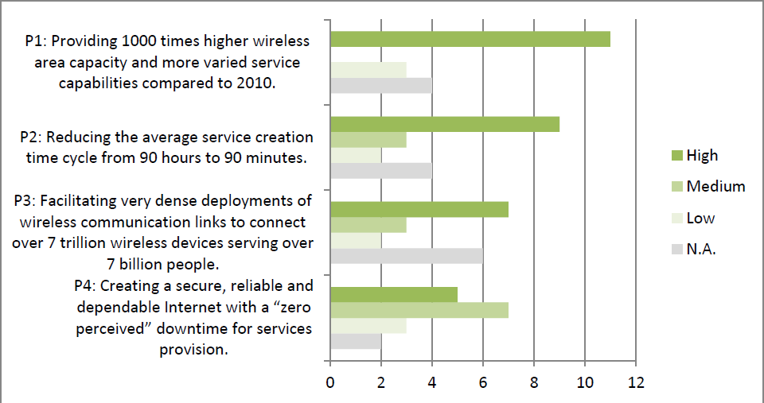
Performance KPIs

Slide 8
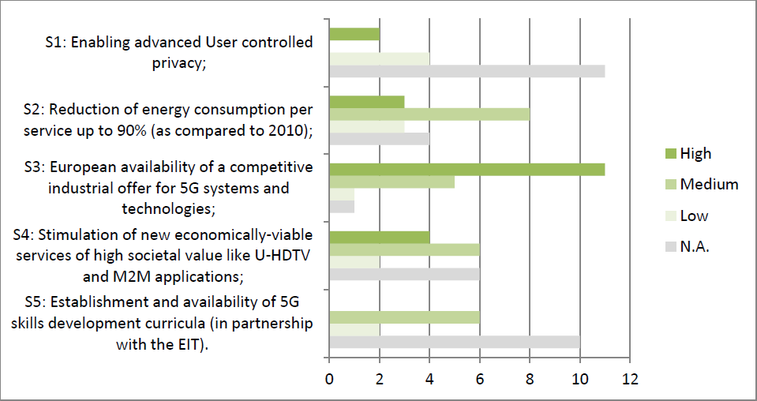
Societal KPIs

Slide 9
Governance of the programme
The Steering Board provides guidance on the overall partnership initiative, including:
  the cooperation between Actions and joint events to promote results of the Actions, concepts and systems,
  recommend on collaboration and synchronisation of activities, including but not limited to on management of outcomes, common approaches towards standardisation, SME involvement, links with regulatory and policy activities, and commonly shared dissemination and awareness raising activities.
The Technology Board organises technical meetings and workshops, and establish calls within the organisation for research proposals to address research gaps.

Slide 10











Working Groups
Pre-standards
Spectrum
Vision and Societal Challenges
Architecture
Use cases and performance evaluation models
Software Networks
(SDN and NFV)
Activity 5G PPP Contractual Arrangement, KPIs
Activity 5G International cooperation
Network Management, QoS and Security
Activity Community building and Public Relations
SME support

Slide 11
http://5g-ppp.eu
Thank you for your attention!

