Slide 1
Energy & 5G meeting
Didier HINGANT
Pôle Télécom, Enedis
14/03/2017

Slide 2
Radio Systems’ challenges to be taken up by DSO
Augmented Reality
Nation wide radio coverage
New ways of working in mobility
Connectivity on every sites with improved service level
More and more devices
BIN
Existing PMR solutions will become outdated
Proprietary networks are expensive and run into legal constraints
DSO may rely on Telecom Operators’ Managed Services

Slide 3
Overview of a few services enabled by
Site availability improvement
WAN Connectivity to every sites
Provide WAN Backup to primary distribution substation
and other critical sites
Connect ~750.000 secondary distribution substations
at affordable OPEX and high availability
Automatic handover
Equal service level (Bandwidth, Latency, QoS)
National roaming with real-time handover
Traffic prioritization in case of congestion
Always-on network even when terrorist incident
IoT Network
Provide low power, low cost, secured connectivity for line fault detection system and other connected sensors
Crisis communications enhancement
Nationwide Deep indoor coverage
Higher security level
Devices interoperability
Provide a reliable data + voice network (PMR)
5G autonomous cell capabilities
Nationwide coverage

Slide 4
Key points to make Telco’s 5G a success for DSO
Nation wide coverage, not only in urban areas
DSO grade 5G network slice to serve specific services
Legal agreement to enable Real-time Roaming
and trafic priority
In the future, people & things will be always more connected
There is no doubt: Telcos are going to provide the accurate service level

Slide 5
Contact
Prénom Nom
T : +33 (0)1 00 00 00 00
M : +33 (0)6 00 00 00 00
prenom.nom@enedis.fr

Slide 6
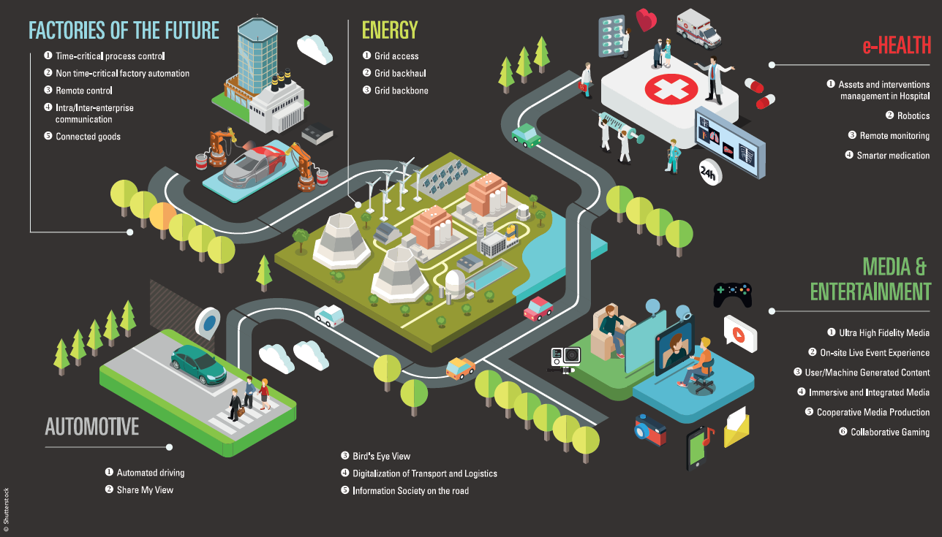
5G: A Driver for industrial & societal changes

Slide 7
Primary substation availability improvement
MPLS backbone
#1
2 300 primary substations
Landline
MPLS backbone
#2
30 Operation Centers
Automatic handover from landline to 5G
Equal service level (Bandwidth, Latency, CoS)
No Single Point of Failure
Multi-VPN ready
IPv6 ready
Low OPEX

Slide 8
Connect up to 750 000 2^{ndary} distribution substations
Mobile Network
#2
Mobile Network
#1
Mobile Network
#3
National Roaming
Terrorist using mobile network to communicate
Low priority
High priority
Standard users with smartphone
750 000 secondary substations
National roaming with real-time handover
Traffic prioritization in case of congestion
Always-on network even when terrorist incident
Low OPEX

Slide 9
Crisis communications enhancement
From Voice (PMR)
To Data + Voice & Video
5G autonomous cell capabilities
Nationwide coverage
Autonomous cell

Slide 10
Smart Connect IoT Platform
NB - IoT
- M
IoT
IoT Hub
Data treatment
Data exposure
HMI

Slide 11
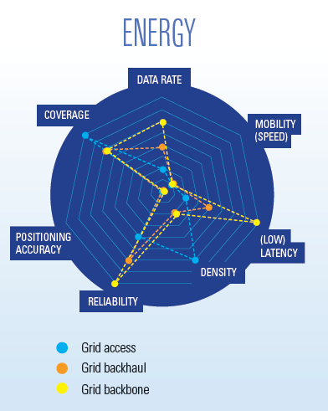
5G PPP vision regarding DSO needs
Source: 5G PPP white paper « 5G empowering vertical industries »

