Slide 1
5G PPP
Stakeholders event
From Phase 1 to Phase 2
Thibaut KLEINER*
European Commission

Slide 2
5G PPP
- Public Private Partnership (PPP) research programme
Up to 700 million € public funding
Matched by expected private funding of about 3.5 billion €
- Covers policy areas too
Pre standardisation
Spectrum
International cooperation
- Implementation through an Industrial Association, 5G-I-A
- 3 Phases until 2020

Slide 3
5G-PPP Key ambitions
5G-PPP Program aims at delivering technologies, architectures and solutions to future 5G communication infrastructures
Support of 5G-PPP targeted outcomes in global standards is a priority
Program Ambitions: Key Challenges / High-level KPIs
Providing 1000 times higher wireless area capacity and more varied service capabilities compared to 2010
Saving up to 90% of energy per service provided. The main focus will be in mobile communication networks where the dominating energy consumption comes from the radio access network
Reducing the average service creation time cycle from 90 hours to 90 minutes
Creating a secure, reliable and dependable Internet with a “zero perceived” downtime for services provision
Facilitating very dense deployments of wireless communication links to connect over 7 trillion wireless devices serving over 7 billion people
Enabling advanced user-controlled privacy

Slide 4
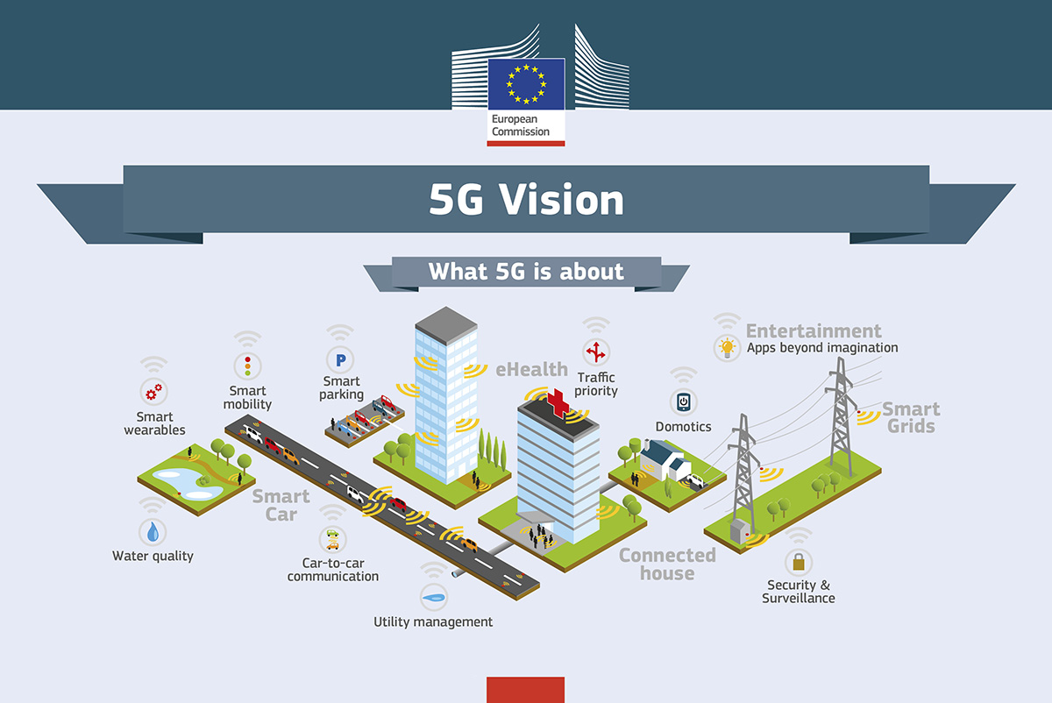

Slide 5
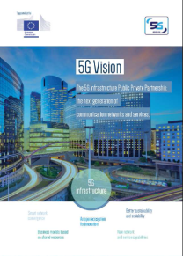
5G-PPP Approach
5G = digital infrastructure supporting ecosystem for business innovation
Value-added services
Immersive user experience
Expanded Internet of Things
New mission critical services (low latency, high reliability)
Unified and programmable infrastructure
Support of multi tenancy and network resource slicing models
Design to be a sustainable and scalable technology
Commercial deployment of 5G systems in years 2020+
Field trials from year 2018 onwards, not yet based on commercial products
First commercial roll-outs expected to start in year 2020
http://5g-ppp.eu/wp-content/uploads/2015/02/5G-Vision-Brochure-v1.pdf
Notes:
Main characteristics based on the Vision paper. Key message on timing, avoid rushing the process of 5G definition.
Put importance of emergence of a full 5G ecosystem, not limited to one or the other "priority" service

Slide 6
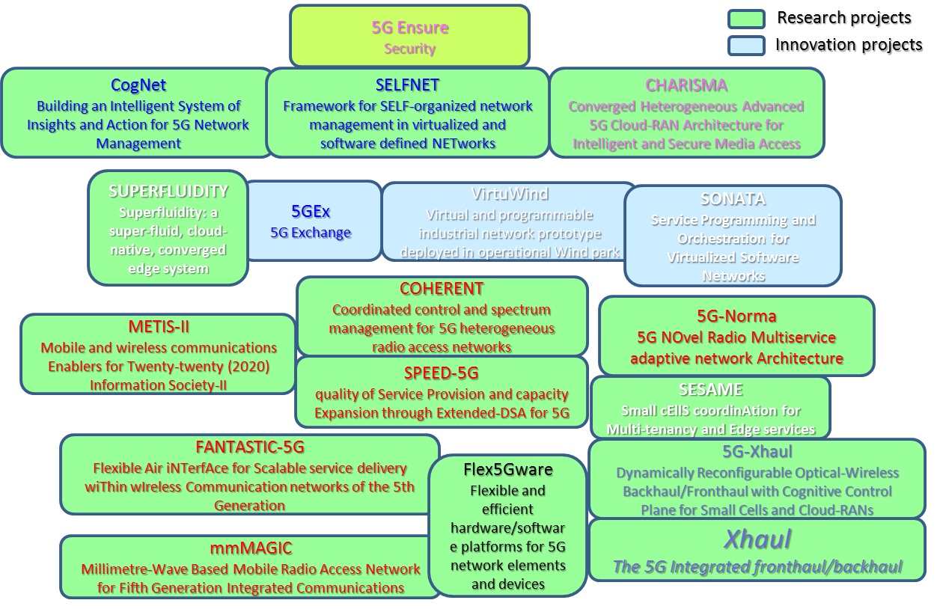
5G-PPP R&I Projects
Launch: 1st of July 2015
Notes:
Message: Holistic view, complete prog integration. Key:
RED: Radio projects and architectures, RAN
BLUE: Network Management
WHITE: SDN/NFV
BLACK: Components and enabling technos
GREY: Backhaul/fronthaul
PINK: security

Slide 7
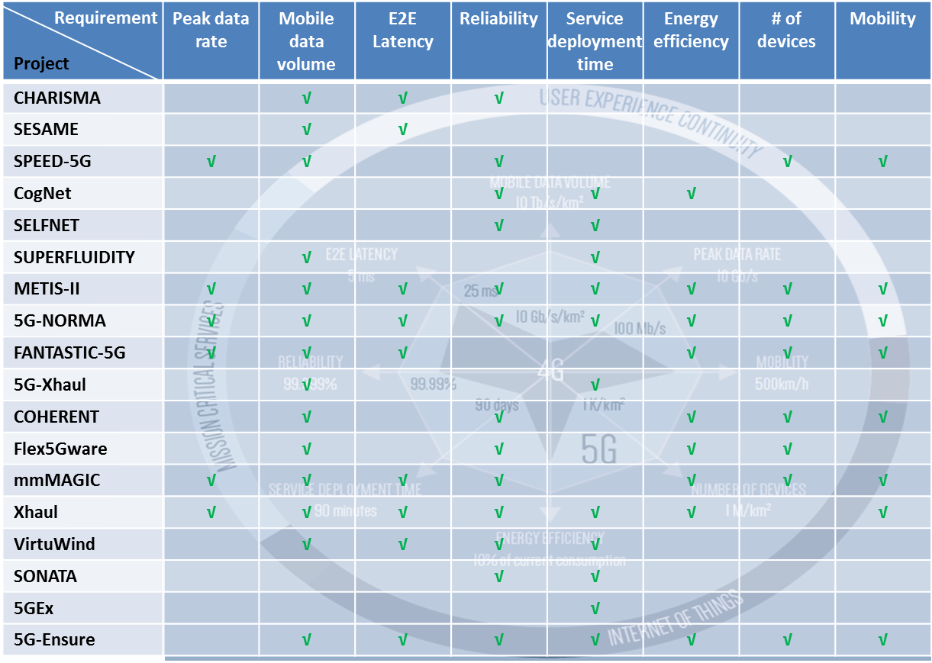
Projects vs KPI's

Slide 8
Integration and Working Groups
Vision & Vertical
Standards
Spectrum
KPI's
Evaluation
Framework
Architecture
Network
Management
SDN/NFV
Virtualisation
International cooperation

Slide 9
Trailblazing Verticals
5G Vision Paper published MWC 2015
EC Study on socio-economic impact 5G
EU White papers on key verticals for MWC 2016 (5G-PPP)
Phase 2 PPP
Graphic: Harvard Business Review Sept. 2015

Slide 10
White Paper Overview
Automotive
Energy
Factory
Healthcare
Media
Graphic: Harvard Business Review Sept. 2015

Slide 11
5G R&I phase 2: 2017-2019
Focus on Proof of Concepts, Experiments, Verticals
Critical technologies and Systems (€100 m)
Radio Network and Architectures
Optical Core
SDN/NFV, architecture, net mgt;
Convergent technologies (€45 m)
Optical support to access
Network apps
Research cooperation in access nets (Taiwan)
International cooperation (6M€ for 5G with SK and JP);
Support Action (€3m)

Slide 12
Some highlights
Phase 2 = re-inforced programme dimension
Testbeds and testing with verticals
SME participation >20%
Holistic perspective
Satellite

Slide 13
Main 5G Call planning
ICT-07-2017 & ICT-08-2017:
Opening: 10 May 2016
Closing: 08 Nov 2016

Slide 14
Designed to impact
5G research in FP7 and
in the private sector
5G PPP Phase I
5G PPP Phase II
5G PPP Phase III
Results from FP7
Projects contributed
to ITU-R on 5G vision
and requirements
3GPP Work Items and 3GPP Releases
3GPP Study Items
ONF, Open Daylight, OPNFV, Open Stack, …
ITU-R Vision and Recommendation
WRC preparatory process
Contributions to standardisation and regulatory process via member organisations in respective bodies
Interaction also with the
Trials
Prototype and product development
TIME
Notes:
Not only R&D, interactions with Standards and spectrum are sought

Slide 15
International Cooperation
5G Joint Declarations signed with:
South Korea
Japan
China
Mirrored by MoU at 5G-I-A level with
5G Forum
5G MF
IMT 2020 (5G) Promotion Group
Other
MoU US 4G america; FCC discussions
Taiwan, Joint Research agreement

